Slide 1
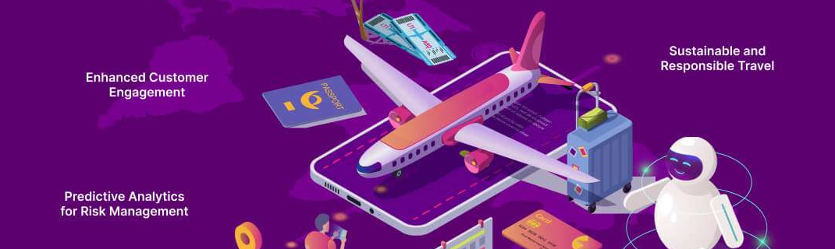
PROCEDURES TO IMPLEMENT CHATGPT IN TOURISM CONTENT GENERATION THROUGH MULTIMODAL ANALYSIS AND CRITICAL ENGAGEMENT: APPLICATION OF AI IN DEVELOPING PROFESSIONAL SKILLS FOR ESP LEARNERS
Leveraging ChatGPT and other AI tools to enhance tourism content generation, while emphasizing the importance of critical engagement and professional skill development for ESP learners.

Slide 2




WORKSHOP OVERVIEW
Critical Engagement
Concept Development
Active Participation
Comparative Analysis
Workshop focuses on critical engagement with the main steps of promotional content generation
From concept development to content optimization
You will actively engage in adapting and generating tourism texts with and without the aid of AI
Allowing for a comparative understanding of each method's strengths and weaknesses

Slide 3



HANDS-ON APPROACH
Adapting Tourism Texts
Generating New Tourism Texts
Comparative Analysis
You engage in adapting existing tourism texts to new contexts and purposes, with and without the aid of AI.
Then, you will create new tourism-related content, both manually and with the assistance of AI tools like ChatGPT.
Finally, you will evaluate the strengths and weaknesses of each method, identifying the benefits and limitations of using AI in tourism content generation.
How to effectively implement ChatGPT and other AI tools for the creation of high-quality, context-appropriate tourism communication materials.

Slide 4



THEORETICAL FRAMEWORKS
Language of Tourism
Semiotics of Tourism
Prompt Engineering
Analyze and apply linguistic features that characterize tourism discourse, including persuasive language, descriptive adjectives, and emotive vocabulary.
Examine the visual and multimodal elements of tourism texts, such as images, symbols, and layouts, and how they convey meaning and construct destination representations.
Translate theoretical insights into clear, specific, and purpose-driven prompts to guide the AI in generating tourism content that aligns with professional standards.
By grounding the use of ChatGPT in robust theoretical frameworks, you will develop the necessary expertise to leverage AI tools while maintaining control over the content generation process and ensuring the quality and effectiveness of the final product.

Slide 5


CRITICAL CONTENT ANALYSIS
Evaluate ChatGPT's interpretation of communication objectives
Assess the alignment between AI-generated content and target audience
Analyze how ChatGPT's generated content reflects the intended meaning and connotations of the original prompt
Determine if ChatGPT's output successfully resonates with the intended tourism segment based on the provided context
Explore the semiotic resources utilized by ChatGPT
Identify potential biases or limitations in ChatGPT's generation
Examine the visual, linguistic, and multimodal elements used by ChatGPT to convey the desired messages and evoke specific responses
Critically analyze the AI's tendencies to reproduce certain tourism tropes or miss nuanced aspects of the communication
Do you want to gain a deeper understanding of the AI's capabilities and limitations in translating communication objectives into effective and meaningful tourism materials? Leveraging AI while maintaining professional standards and creativity.

Slide 6



ESSENTIAL SKILLS DEVELOPMENT
Collaboration
Critical Thinking
Foreign Language Learning
Balance between Standards and Creativity
Participants work together to adapt and generate tourism texts, fostering teamwork skills
Participants critically analyze AI-generated content, developing analytical and evaluative skills
The workshop focuses on developing communication skills in English for tourism purposes
Participants learn to leverage AI while maintaining professional standards and creative expression

