Slide 1
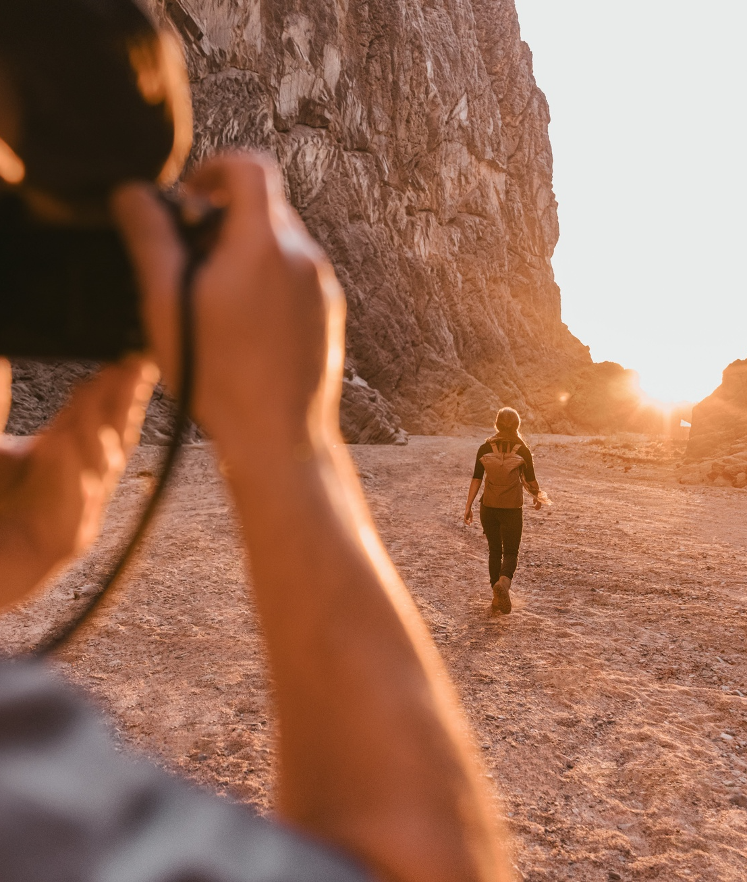
Workshop: Exploring the Power of AI-Assisted Content Creation
Exercises focused on exploring the power of AI-assisted content creation in the tourism industry

Slide 2




1. Analyzing an IG Post
Visual representation
Verbal representation
Social semiotics
Appraisal theory
Analyze the visual elements of the Instagram post, including the entities, composition, use of color, type of imagery
Examine the textual content of the post, including the caption, hashtags, and any other written elements
Interpret the social and cultural meanings conveyed through the visual and verbal elements of the post
Assess the emotions, attitudes, and evaluations expressed in the post through linguistic and visual cues
By analyzing the Instagram post through the lens of social semiotics and Appraisal theory, we can gain a deeper understanding of the visual and verbal representation, as well as the underlying emotions and evaluations conveyed to the audience.

Slide 3




2. AI-Powered Analysis
Use Chat GPT to analyze the same image and text
Employ DALL-E to generate visual analysis
Compare AI-generated insights to human analysis
Detect biases
Prompt Chat GPT with details about the context (when and where), purpose, and target audience to generate insights about the visual and verbal representation, emotions, and evaluations conveyed.
Provide DALL-E with the image and relevant context to explore how the AI interprets and represents the content visually.
Examine the similarities and differences between the AI-powered analysis and the previous social semiotics and Appraisal theories-based examination of the content.
Critically assess the AI's interpretation and representation of the content, considering the underlying data and potential biases that may influence the analysis.
Benefits, challenges, biases

Slide 4



3. Optimizing Content with AI
1- Understand audience preferences
2- Identify appropriate channels
3- Consider changes in terms of content format and style
Leverage ChatGPT's suggestions (Ask AI)
Analyze/define the target audience's demographics, interests, and content consumption habits to optimize content for better engagement.
Determine the most suitable social media platforms, websites, or other channels to reach the target audience effectively.
Propose changes of the content's structure, length, language, and visual elements to cater to the preferences of the new audience or channel.
Use ChatGPT to generate ideas and recommendations for optimizing the content, considering the specific parameters provided.

Slide 5
4. AI-Generated Content Creation
1. Generating Text and Image Content
  Create new text and image content based on specific parameters such as purpose, type of tourist experience, target audience, and channel. Brainstorming first!
2. Experimenting with AI Models
  Options:
  - Upload an online text and ask to create a coherent visual representation
  - Create a text in groups, upload it and ask to create an image
  - Ask AI to create both text and image
  - Ask AI to create an image only based on a concept
2.1 Evaluating AI-Generated Output
  Assess the quality, accuracy, and alignment of the AI-generated content with the specified parameters and tourism-related goals.
2.2 Iterating and Refining
  Continuously refine the prompts and experiment with different AI models to optimize the quality and effectiveness of the generated content.
2.3 Prompt engineering
  Do you think you have provided effective prompts that provide the necessary context and guidelines for the AI to generate relevant and compelling content?

Slide 6
5. Analyzing AI-Generated Output
(General prompt)
Evaluate the visual content
  Analyze the visual elements, composition, and representation of entities in the AI-generated output with general questions such as: generate an image of persuasive/responsible travel
Examine the textual content
  Scrutinize the language, tone, and narrative conveyed in the AI-generated text. What is represented?
Consider the underlying data
  Understand the data sources and training models that inform the AI's output. Guiding questions: What kind of data is AI output built on? Why does AI consider certain representations ‘compelling’?
Identify potential biases
  Recognize and address biases that may be reflected in the AI-generated content. You can ask AI to provide an answer to this question.
Propose alternative narratives
  Develop strategies to promote responsible and sustainable perspectives in the tourism industry
Analysis of AI-generated written content by using a post with high engagement

Slide 7


6. Prompt and output analysis: Bias
The Language of Prompts
2- Revealing Tourism Tropes
Explore how the choice of words, phrases, and descriptors in prompts can shape the AI's representation of tourism-related concepts.
Analyze how the AI's understanding of tourism-related terms and concepts can lead to the perpetuation of common tropes and stereotypes. = how does AI interpret such lexis?
1- Adjectives and AI Output
3- Mitigating Bias in Prompts
Examine how the use of specific adjectives (e.g., 'breathtaking' vs. 'sustainable') in prompts can influence the AI's visual and textual output = encoding tourism tropes and tourist desires in lexis
Discuss strategies for crafting prompts that encourage the AI to generate more diverse, inclusive, and responsible representations of tourism experiences.

Slide 8
Shaping alternatives
Less simplification, more diversity = uniqueness and authenticity
Less exclusionary and sensationalist language = more inclusive, participatory and realistic experience
Identify Stereotypes
Detect Exclusionary Language
Suggest Inclusive Alternatives
Analyze AI-generated travel content for stereotypical depictions of locations, cultures, or demographics.
Identify language that may exclude or marginalize certain groups of travelers in the AI-generated content.
Provide recommendations for more inclusive and representative language, imagery, and marketing approaches.

Slide 9
Sustainable Tourism Content Creation
Assignment - first part
Select a sustainable tourism company
  Choose an environmentally friendly and locally-focused company from the Io sono Friuli Venezia Giulia website
Analyze the company's online presence
  Examine a company's webpage or one Instagram post, looking at the visual and written content
Identify distinctive features
  Extract textual evidence and describe visual elements, such as promoted entities (products, services, people as branding strategy, environments), actions, camera angles and shots, and adjectives (with or without AI; you can also describe the visual content to the machine to avoid copyright infringement)

Slide 10
Sustainable Tourism Content Creation
Assignment - second part
Create a social media post with AI
  Use ChatGPT to generate a social media text and image based on the company's online presence and branding
Options:
  Create a picture by providing Chat GPT with a text already available on the IG account/website of the company
  Create a text in English by providing a description of an image of the account/website
  Create an IG post by making sure you provide information about the objective (raise awareness of the brand values, invite tourists to a particular experience, e.g.), the channel (IG, website), the audience demographics (young/middle-aged, country of provenance), the subject(s), settings, actions, camera shots, the emotions and evaluations that need to stand out
Ensure responsible representation
  Evaluate the AI-generated output to ensure it aligns with the company's values and promotes sustainable tourism

Slide 11
Reflections
What are the benefits of using AI?
List them and discuss them in groups.
Additional key questions:
1. What knowledge is necessary to make sure the output is optimized, original and adherent to professional standards?
2. Discuss the following elements and propose ways to develop or improve communication skills in the era of AI:
a) Conventions of various genres and channels, including vocabulary and registers
b) Content analysis skills: social semiotics, persuasive language, tourism tropes
c)Knowledge about successful content creation examples
d) Knowledge about key distinctive features of your destination
f) Experience with prompting: knowing that language in prompts affects output and that prompts need to be specific
e) Knowledge about the objectives, the audience, the channel when prompting
g) Gaining control over AI through careful prompting and use of adjectives

Slide 12
How do you know if Chat Gpt has done “a good job”?

Slide 13



In conclusion: Benefits of using AI
Enhances Productivity
Improves Decision-Making
Boosts Creativity
Scales Expertise
AI automates repetitive tasks, enabling more efficient workflows and freeing up time for higher-value work
AI can assist in ideation, content generation, and problem-solving, sparking new ideas and perspectives
AI can extend the reach and impact of human expertise, making specialized knowledge more accessible
AI-powered analytics and insights can help make more informed, data-driven decisions
By leveraging the benefits of AI, organizations can drive efficiency, innovation, and growth, while ensuring that the output aligns with professional standards and user expectations.

Slide 14



Key Takeaways
Benefits of AI
Challenges of AI
Necessary Knowledge
Effective Prompting
Increased efficiency, scalability, and consistency in content generation
Potential for bias, lack of nuance, and need for human oversight
Understanding tourism genres, successful content examples, and multimodal analysis skills
Crafting specific, context-aware prompts to guide AI-generated content

