Slide 1


Project Title: Empowering Specialized Language Acquisition with Integrated AI
Project code: 2024-1-RO01-KA220-HED-000248845
Project implementation: 01.09.2024-31.08.2026

Slide 2


Presentation of AI tools

Slide 3
CORAL AI

Slide 4
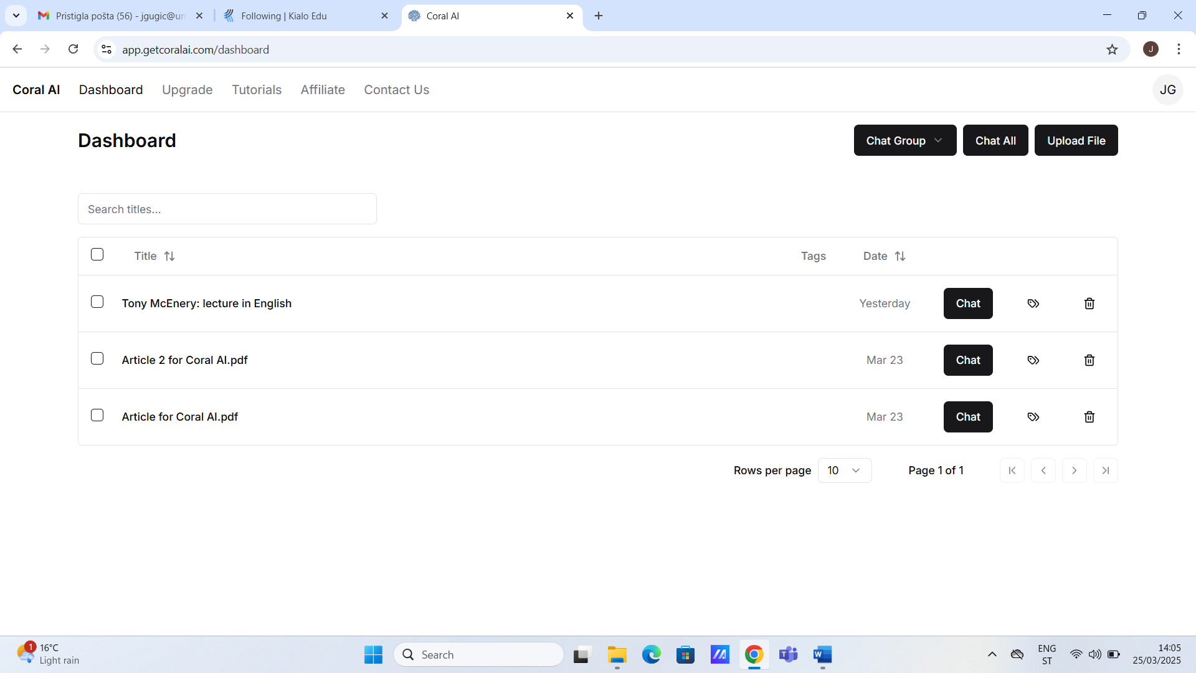

Slide 5
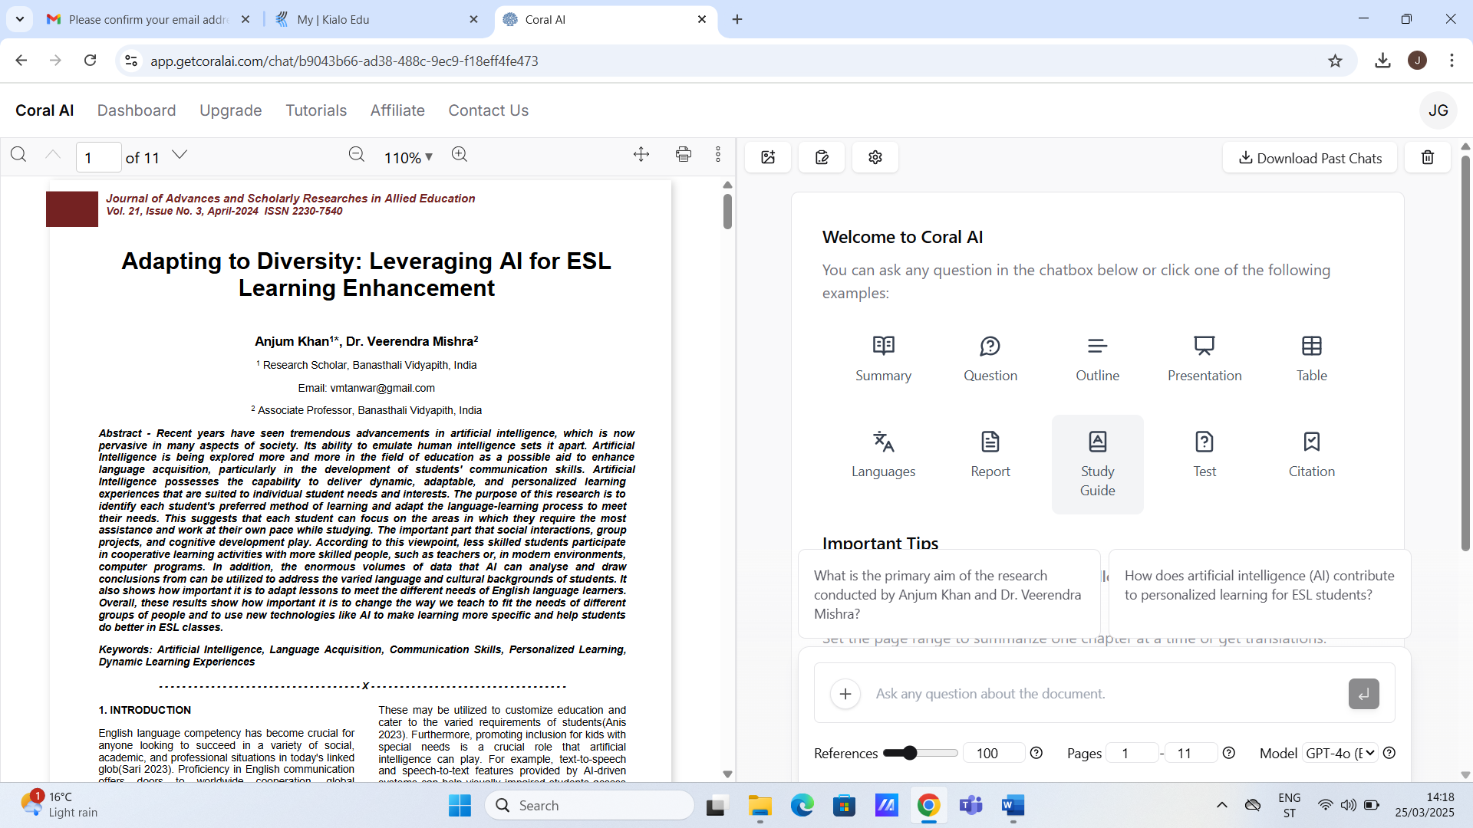

Slide 6
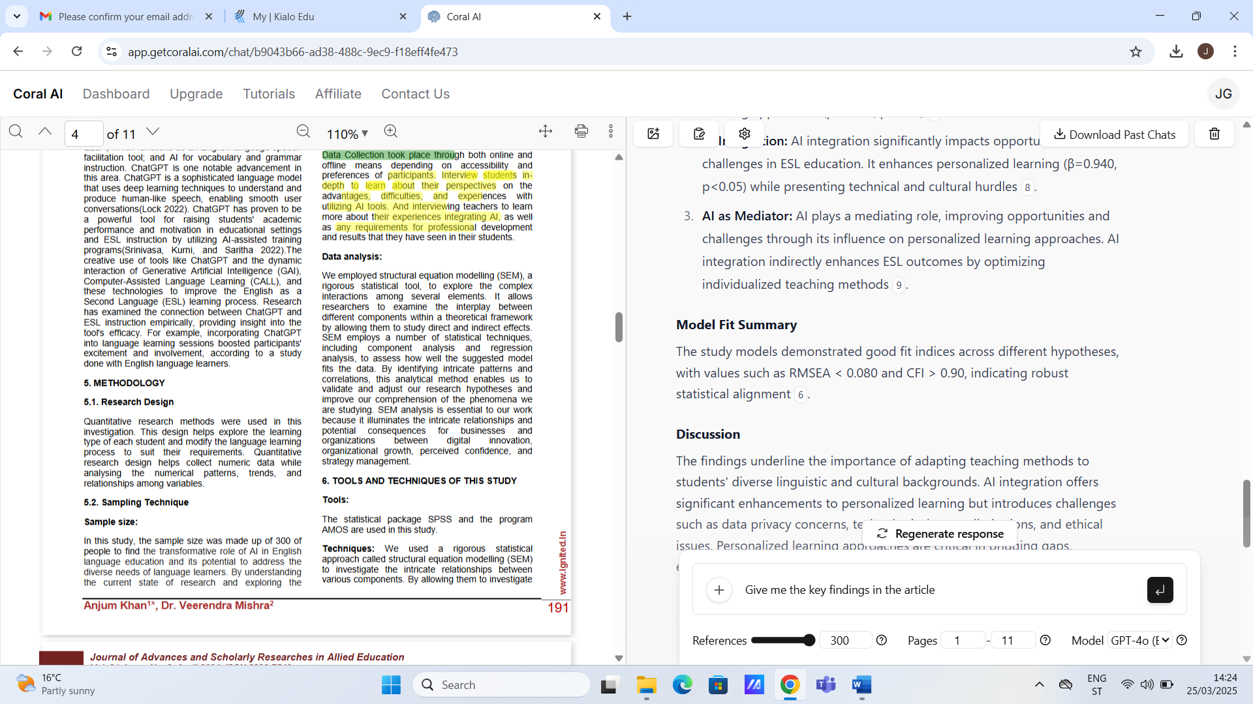

Slide 7
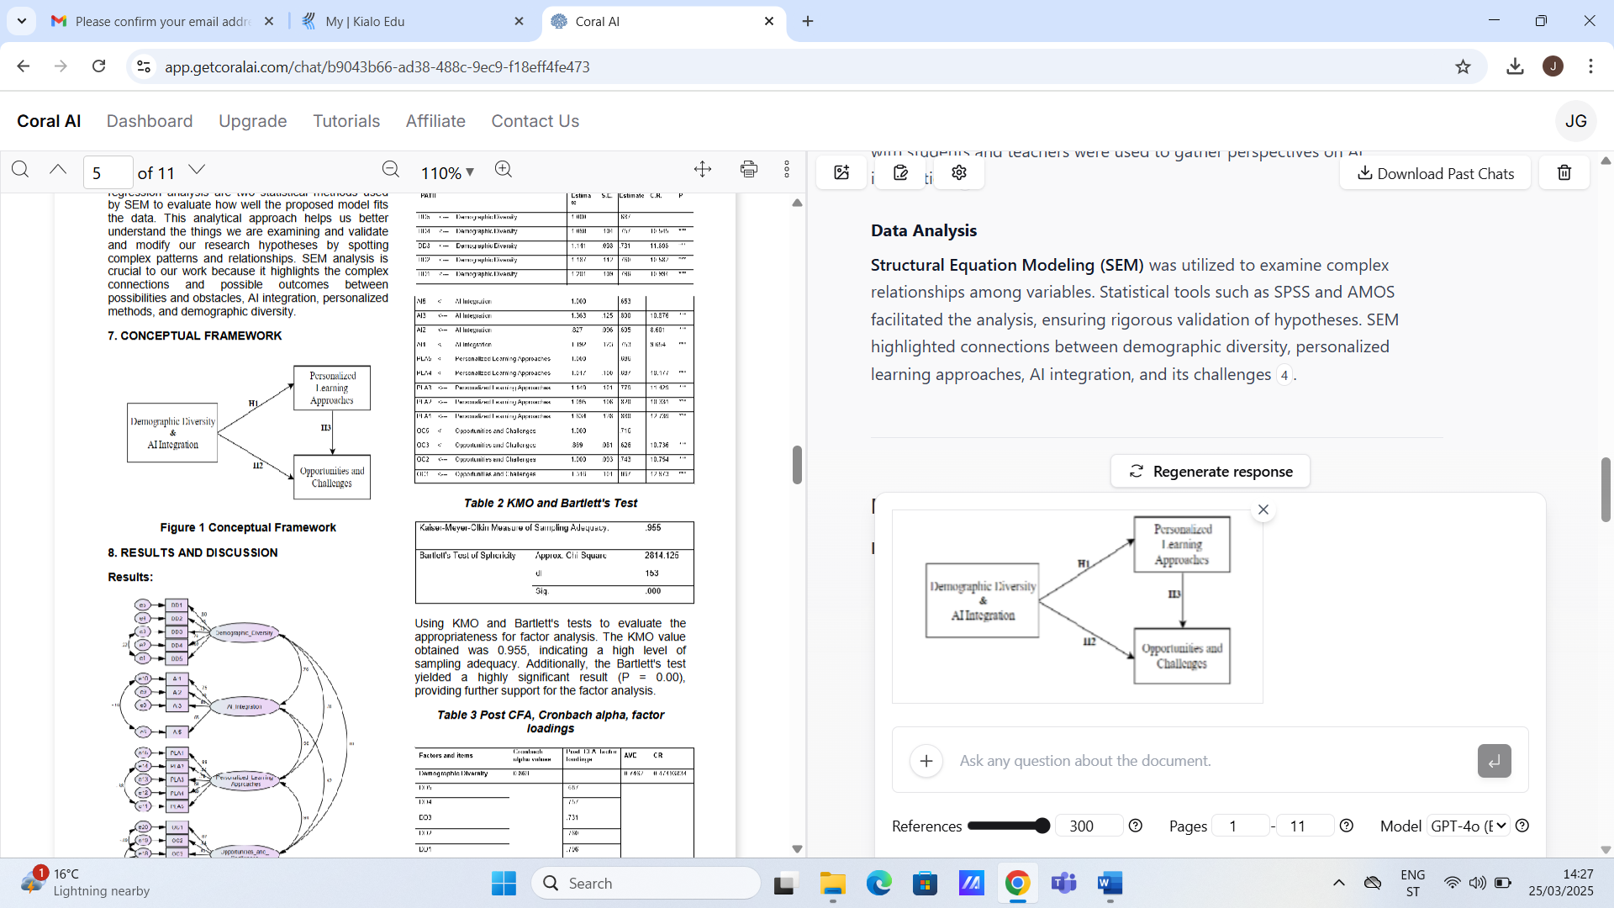

Slide 8
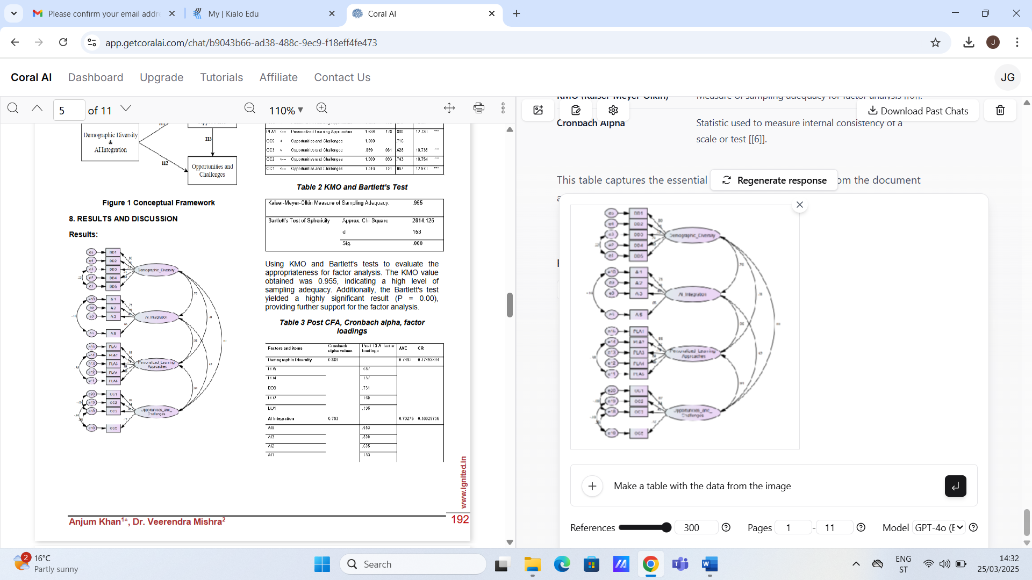

Slide 9
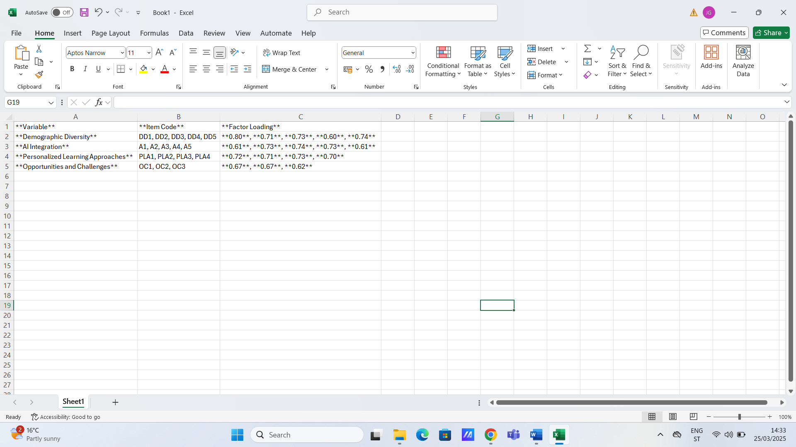

Slide 10
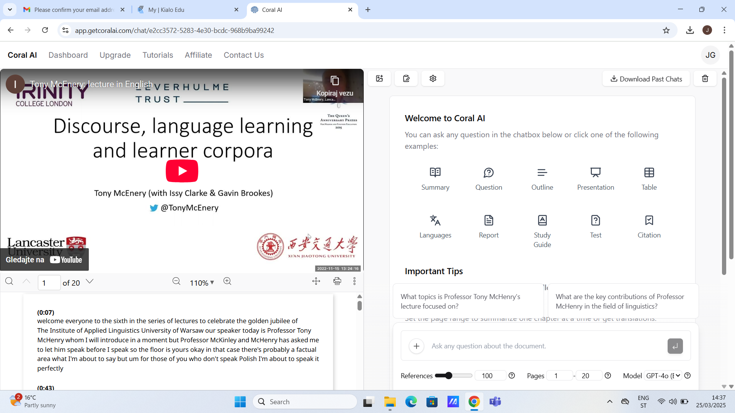

Slide 11
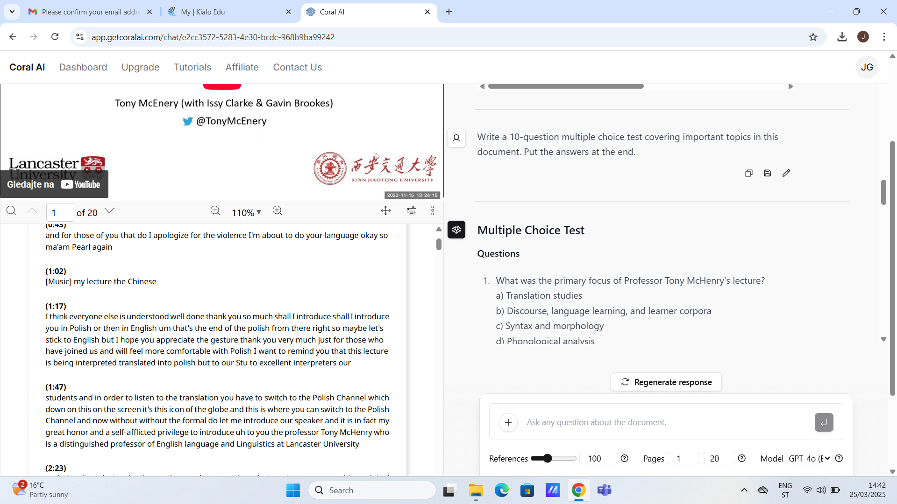

Slide 12
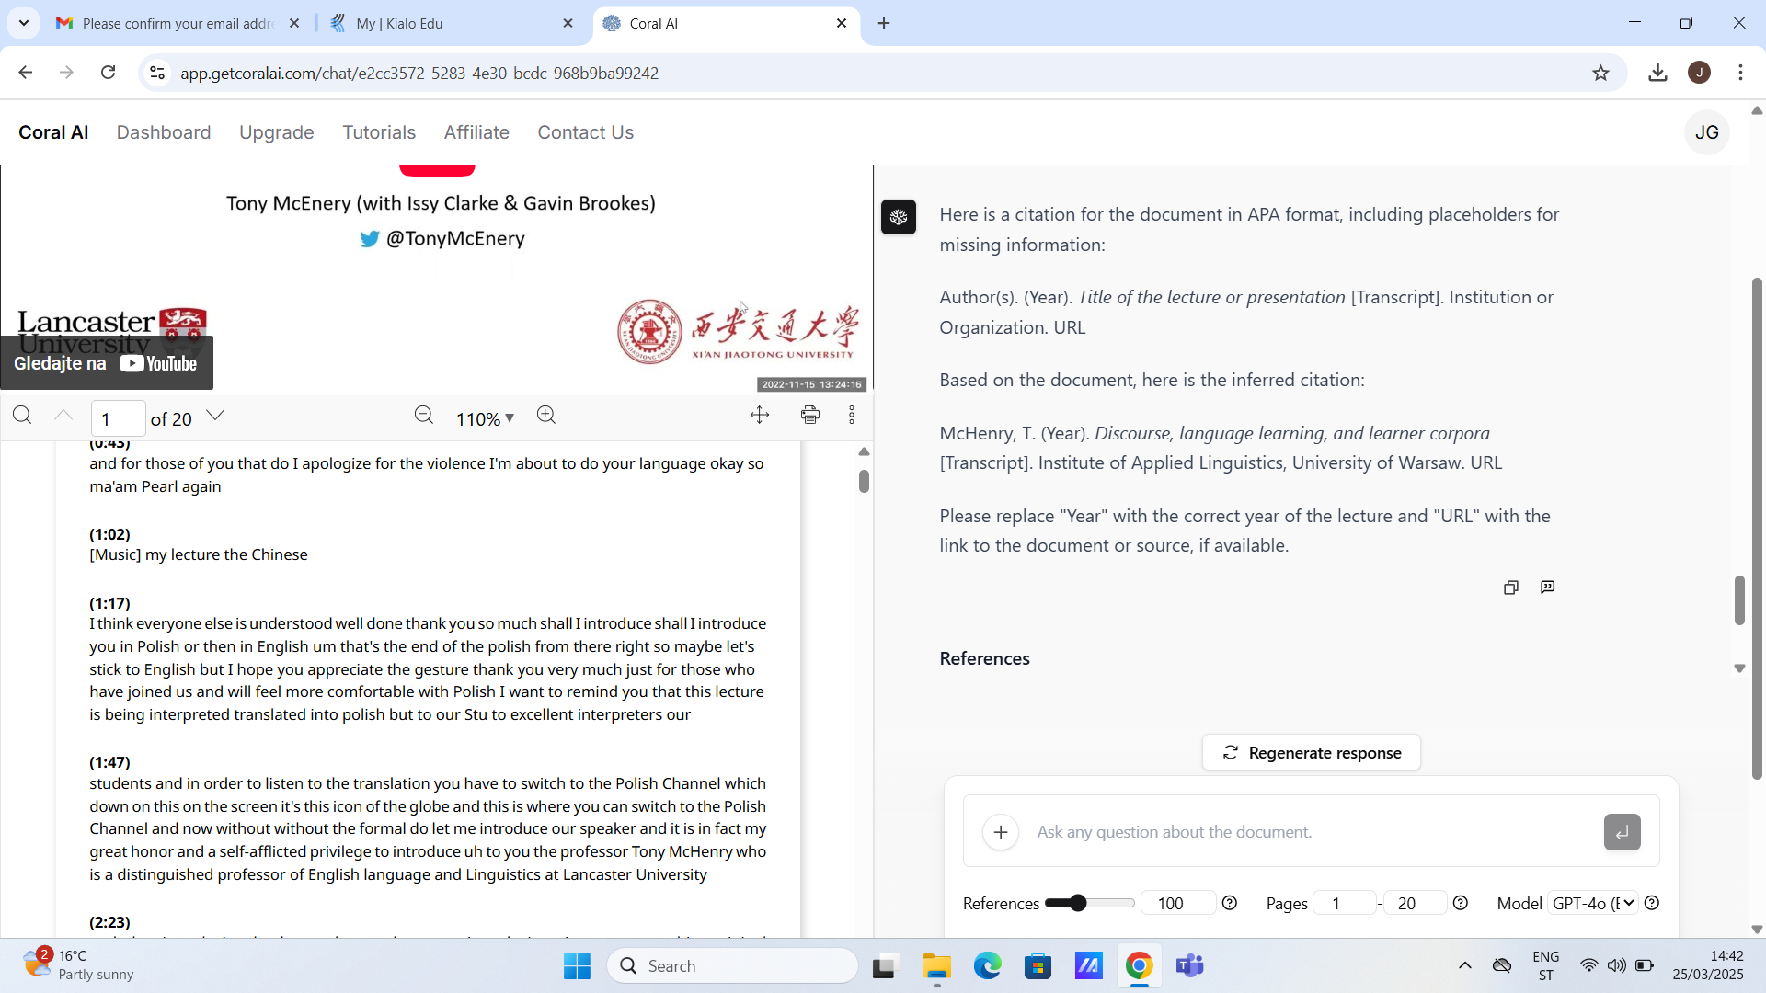

Slide 13
TALENT LMS

Slide 14
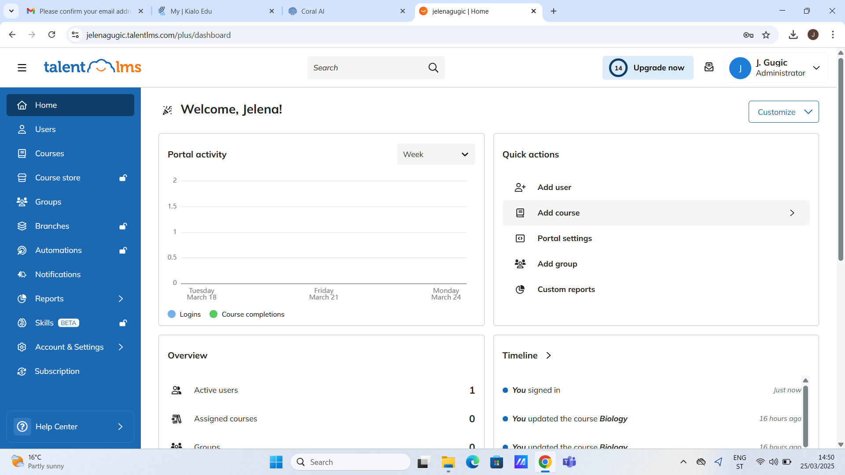

Slide 15
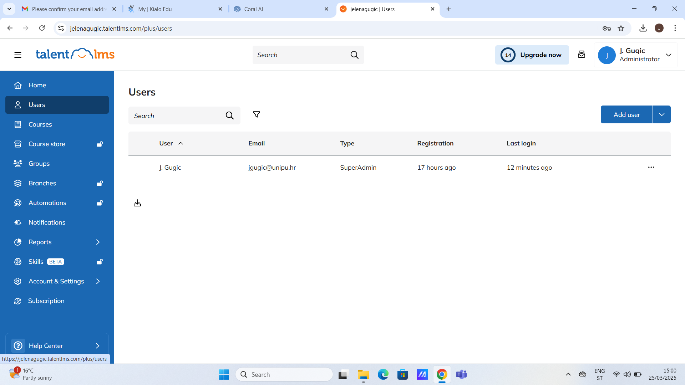

Slide 16
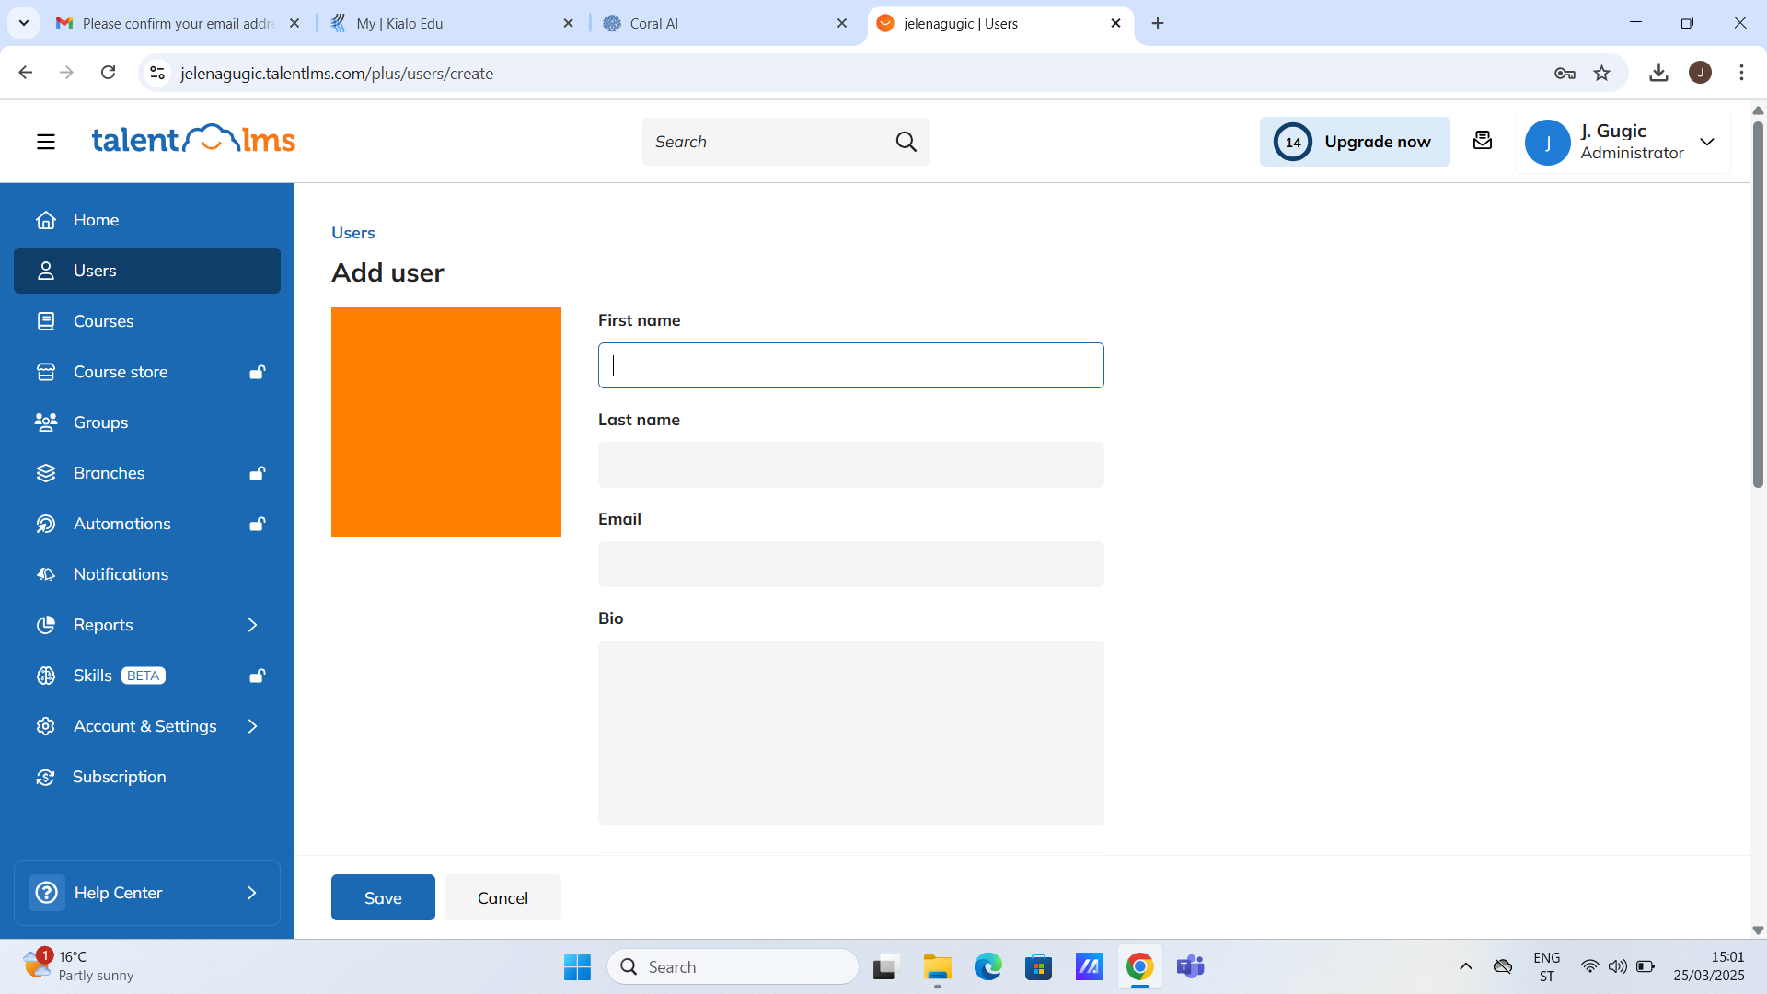

Slide 17
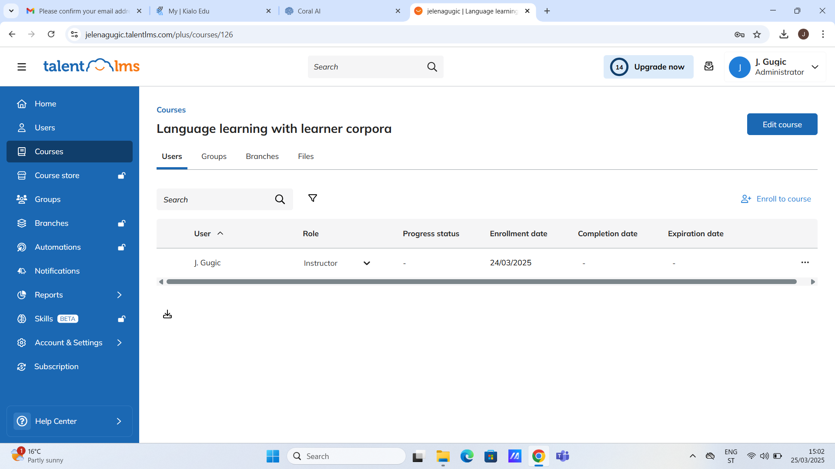

Slide 18
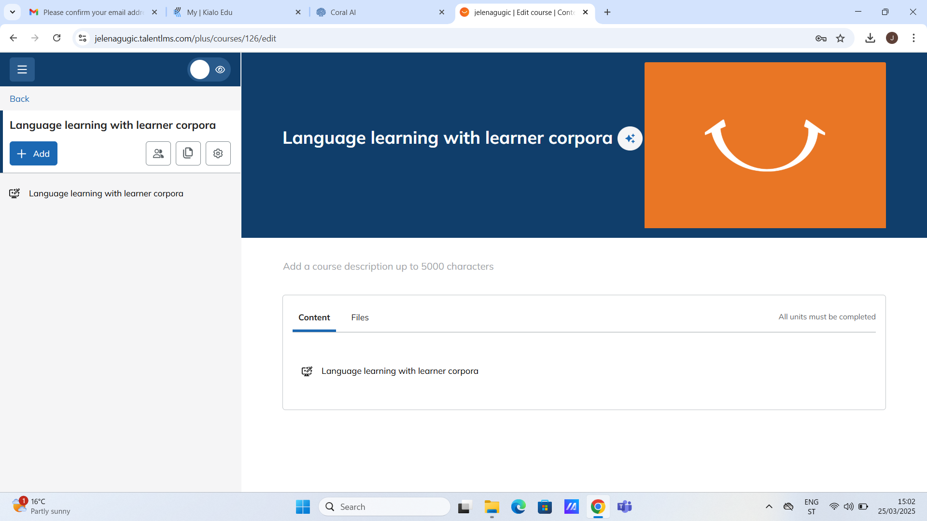

Slide 19
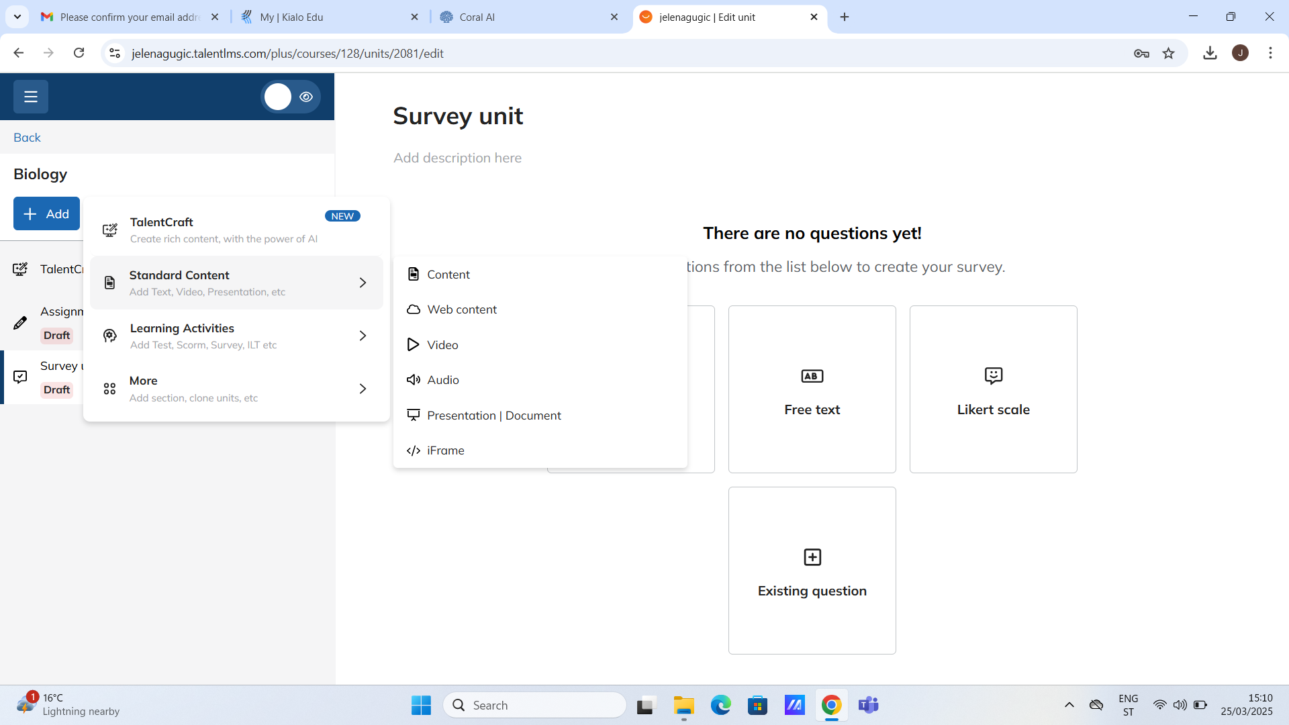

Slide 20

Disclaimer:
This research was supported by the Erasmus + grant number
2024-1-RO01-KA220-HED-000248845 .
Funded by the European Union. Views and opinions expressed are however those of the author only and do not necessarily reflect those of the European Union or the ANPCDEFP. Neither the European Union nor the ANPCDEFP can be hold responsible for them.

