Slide 1







AI in ESP classes
FL/ESP instruction and AI integration. Mapping the Current Situation: literature review, AI tools in action, classroom practices
25 March 2025
Emanuela Li Destri University of Udine
emanuela.lidestri@uniud.it

Slide 2
Roadmap
What has been said about AI in ESP classes?
What are the uses for AI in ESP classes?
What are the advantages?
What are the disadvanteges?

Slide 3
Works on AI integration in Esp classes
Perception surveys: what do students and/or teachers think about AI in ESP classes?
Experimental studies: are there tangible improvements if AI integration is implemented?
Practical applications: examples of AI integration

Slide 4
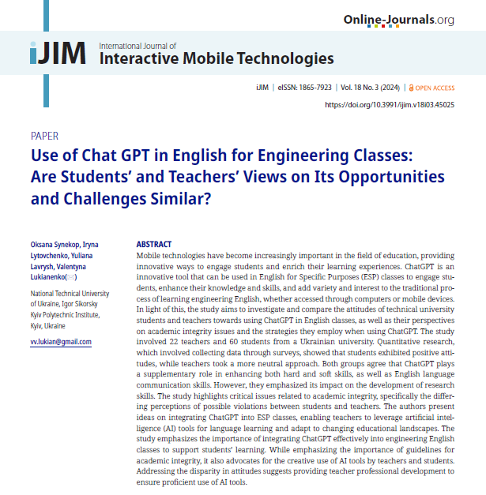

Synekop et al. (2024) investigate the perceptions of 60 students and 22 teachers regarding the application of ChatGPT in Engineering English classes
Students held a positive attitude, while teachers had a more neutral stance
Teachers would preferably use ChatGPT for generating learning tasks/problems for ESP classes (77.3%) and generating topics for students’ reports (63.6%)
Students would preferably use ChatGPT for analyzing stylistic features of texts created by themselves and using ChatGPT (63.3%) and searching for grammar rules with examples (58.3%).
Concerns regarding academic integrity:
  Plagiarism checker
  Co-authorship
  Need for ethical guidelines

Slide 5
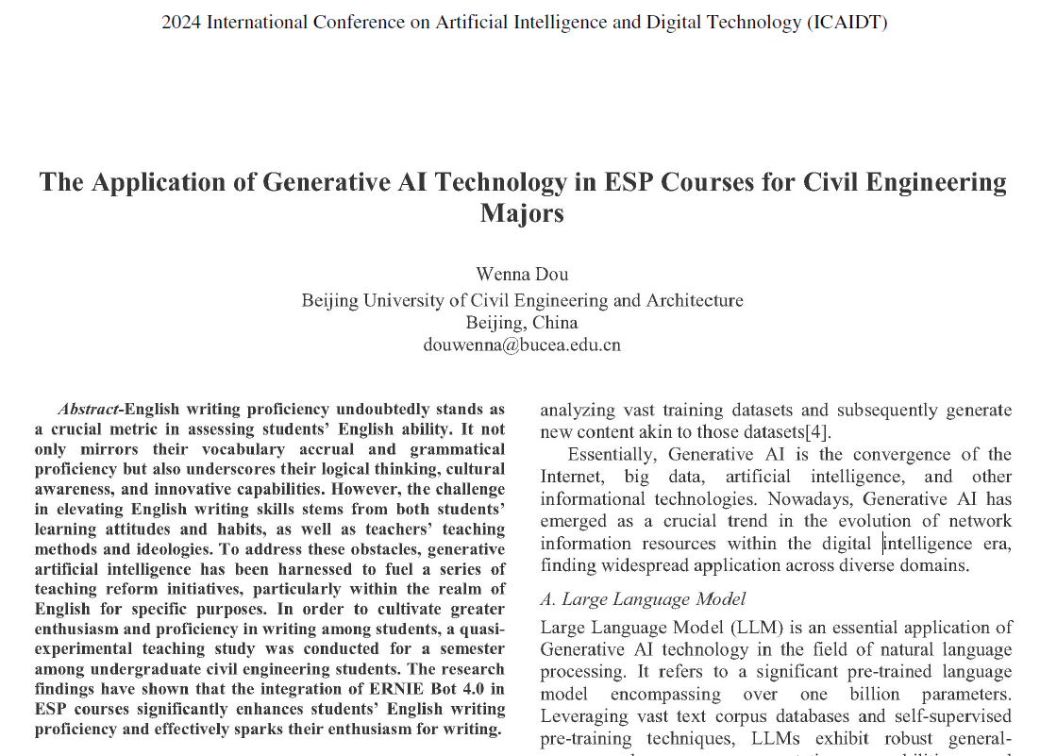
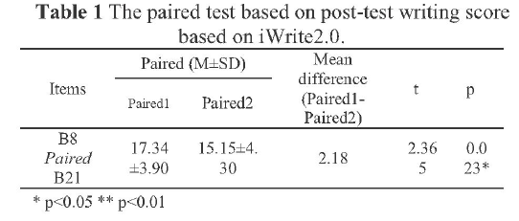
Dou (2024) investigates the use of ERNIE Bot 4.0, a large language model developed by Baidu, in enhancing the English writing proficiency of 80 civil engineering students in English for Specific Purposes (ESP) courses.
The study focuses on two specific functions of ERNIE Bot 4.0 relevant to education: continuation and polishing. The continuation function enables the seamless extension of text, while the polishing function refines language usage and optimizes sentence structure to enhance text quality.
Two classes, comparable in terms of gender ratio, class size, and academic proficiency, undertook the same course, with the sole difference being that one had access to ERNIE Bot 4.0. The experimental group (using ERNIE Bot 4.0) demonstrated significant improvement in their writing proficiency compared to the control group, as evidenced by the paired t-test results of their post-test writing scores.

Slide 6
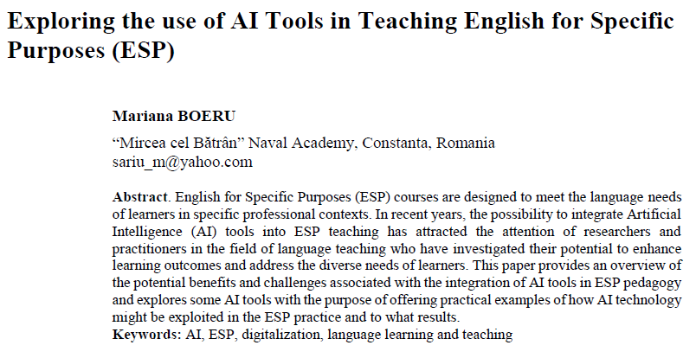
Boeru (2024) discusses in depth how to integrate two AI tools in ESP classes
Diffit for teachers is an AI-powered authoring platform designed to assist teachers in creating individualized materials that cater to students' specific language needs. The tool enables teachers to produce adaptable materials suitable for different proficiency levels, promotes comprehension and engagement through open-ended prompts, offers a variety of question formats and scaffolding.
The article introduces a specific chatbot, The Maritime and Naval English Guide-Maritime English Enhancement, hosted by YesChat.ai. This chatbot aims to improve learners’ professional communication skills through interactive role-plays, voice recognition for Very High Frequency radio conversations, and feedback. The author provides a practical example of using the chatbot to simulate VHF radio communication scenarios.

Slide 7
What are the uses for AI?
Personalization
Student needs
Up-to-date materials
Learning support
Autonomous learning
Continuous feedback

Slide 8
What are the advantages?
Students report:
    Flexibility and freedom to learn at own pace
    Control over learning activities
    Safe space to practice without fear of judgement
    Personalised feedback and error correction
    Support and context-specific examples
    Increased self-efficacy and confidence in tasks
    Sense of companionship and guidance

Slide 9
What are the disadvantages?
Students and teachers report ethical concerns, especially regarding plagiarism
Students report:
    Concerns about accuracy and relevance of responses
    Inability to adjust language levels as students’ progress
    Reduced human interaction and emotional connection
    Lack of social belonging in AI interactions
    Fear of overreliance on AI tools
    Quality of Internet connection

Slide 10
Thank you for your attention!

Slide 11
Selected references
Boeru, M. (2024). Exploring the use of AI Tools in Teaching English for Specific Purposes (ESP). Scientific Bulletin'Mircea cel Batran'Naval Academy, 27(1), 91-96.
Dou, W. (2024, June). The Application of Generative AI Technology in ESP Courses for Civil Engineering Majors. In 2024 International Conference on Artificial Intelligence and Digital Technology (ICAIDT), Shenzhen, China 7-9 June 2024, Los Alamitos, CA, USA, IEEE Computer Society: 144-147.
Du, J., Alm, A. (2024). The Impact of ChatGPT on English for Academic Purposes (EAP) Students’ Language Learning Experience: A Self-Determination Theory Perspective. Education Sciences, 2024, 14, 726.
Ningsih, F. (2023). Classtime. com As An AI-based Testing Platform: Analysing Esp Students’ Performances and Feedback. Journal of Languages and Language Teaching, 11(3), 390-404.
Synekop, O., Lytovchenko, I., Lavrysh, Y., & Lukianenko, V. (2024). Use of Chat GPT in English for Engineering Classes: Are Students’ and Teachers’ Views on Its Opportunities and Challenges Similar?. International Journal of Interactive Mobile Technologies, 18(3).

Slide 12
This research was supported by the Erasmus+ grant number 2024-1-RO01-KA220-HED-000248845.
This research was funded by the European Union. Views and opinions expressed are however those of the author(s) only and do not necessarily reflect those of the European Union or the ANPCDEFP. Neither the European Union nor the ANPCDEFP can be held responsible for them.

