Slide 1


AI TOOLS in action

Slide 2
AGENDA
CHAT GPT4
ID-ASSIST
VOCABULARY.COM
EDUCAPLAY

Slide 3
Prompting with CHAT GPT4 https://chatgpt.com/ in esp teaching

Slide 4
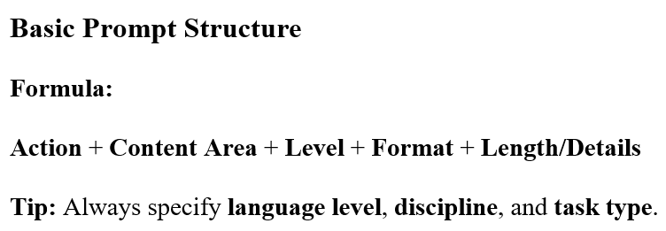

Slide 5
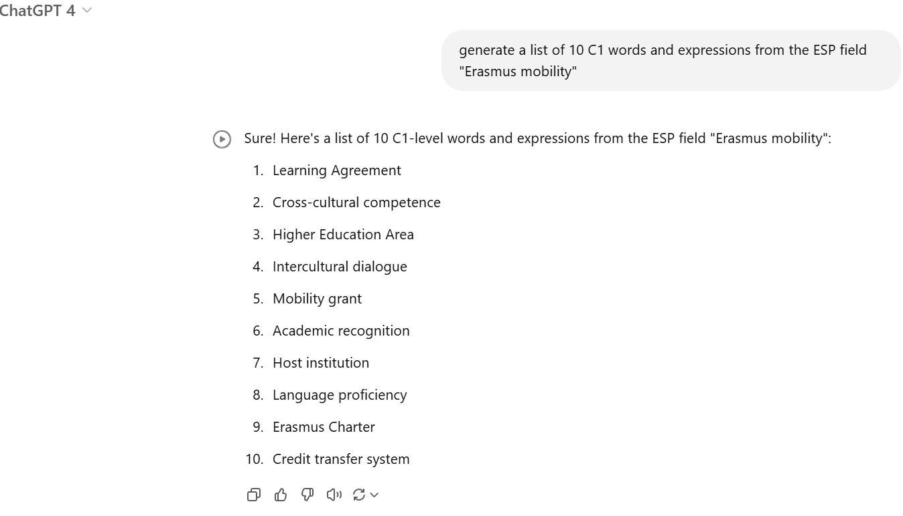
1. ESP VOCABULARY GENERATION
Generate a list of 10 C1 words and expressions from the ESP field “Erasmus mobility”.

Slide 6
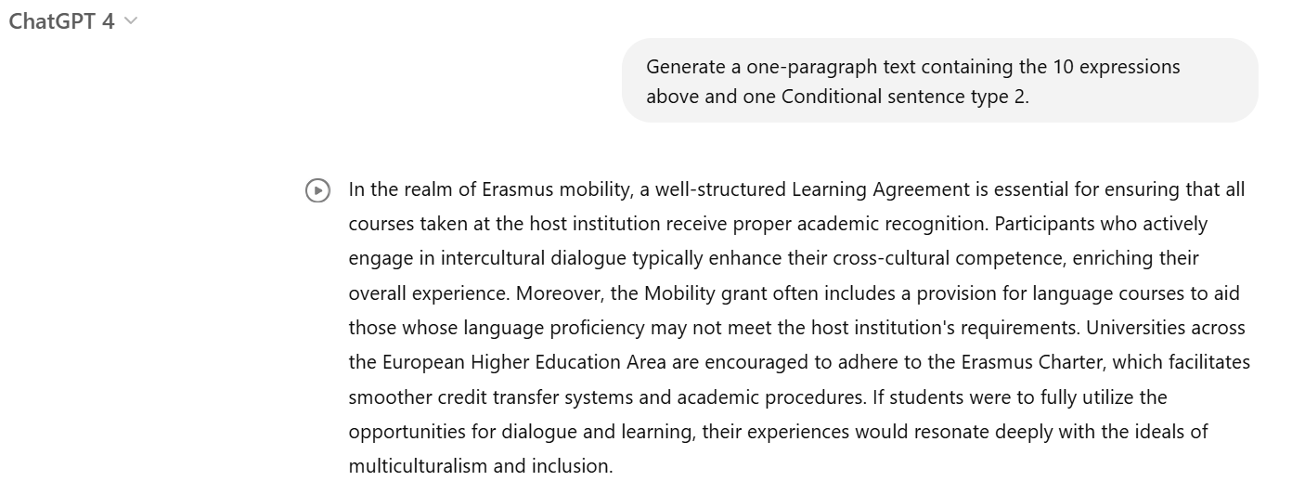
2. Text generation using selected expressions and grammar
Generate a one-paragraph text containing the 10 expressions above and one type 2 Conditional sentence.

Slide 7

Generate one multiple choice vocabulary exercise with key for the 10 selected expressions.

Slide 8
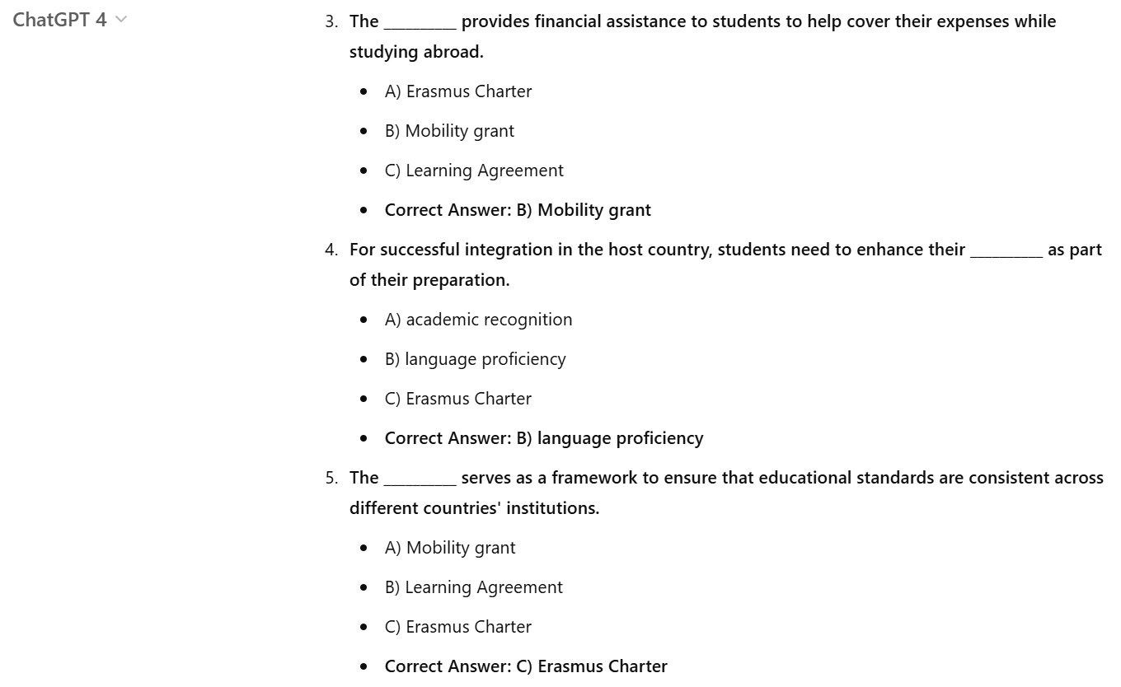

Slide 9


Slide 10
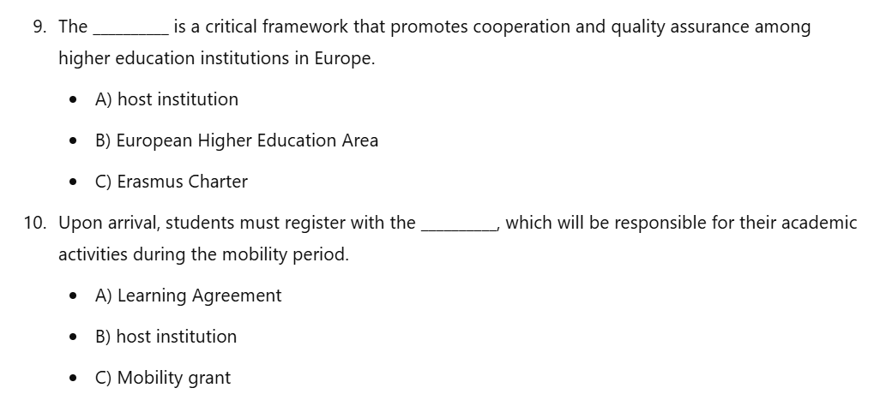

Slide 11
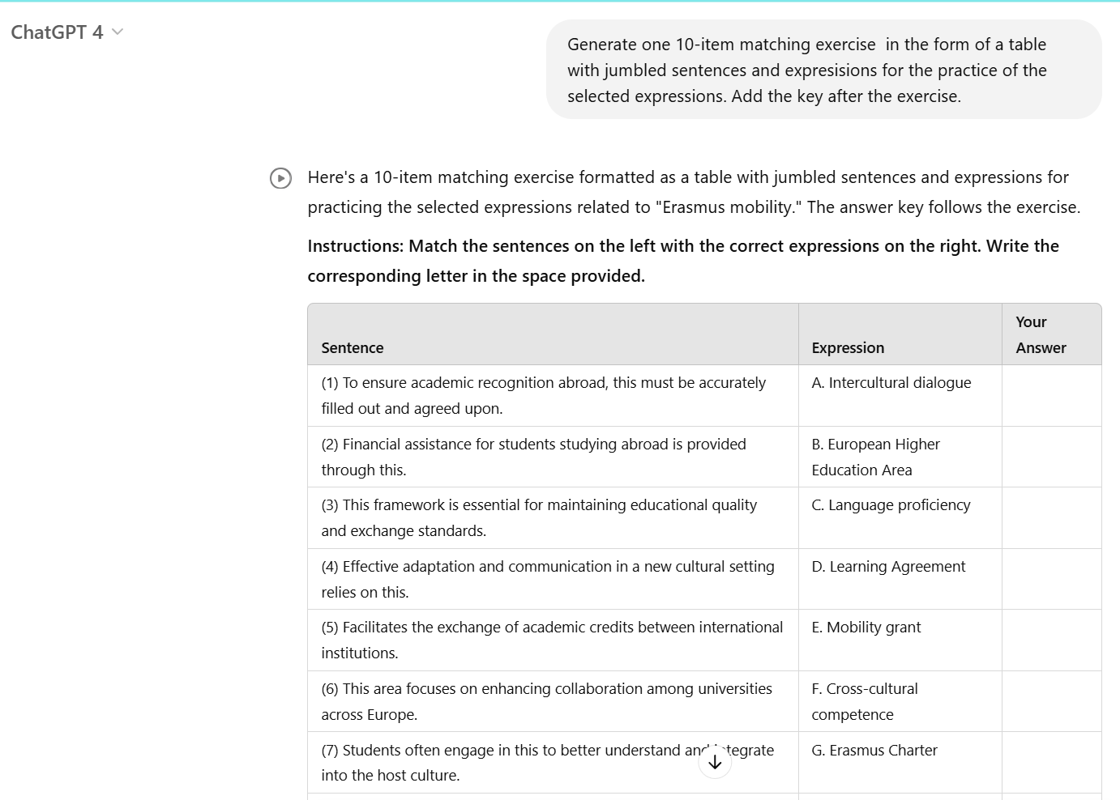
Generate one 10-item matching exercise in the form of a table with jumbled sentences and expressions for the practice of the selected expressions above. Add the key after the exercise.

Slide 12
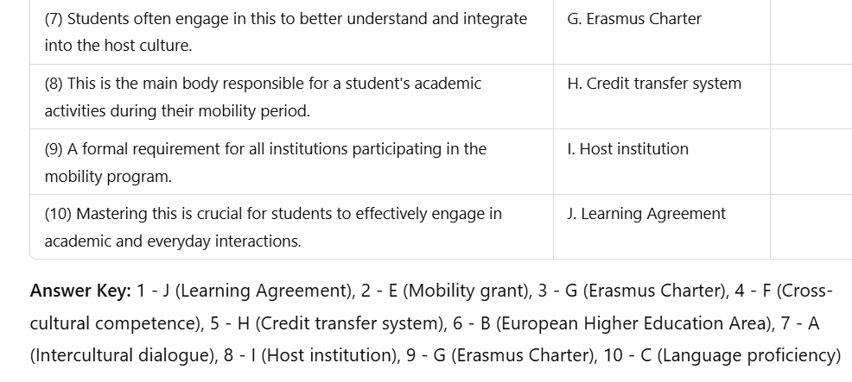

Slide 13
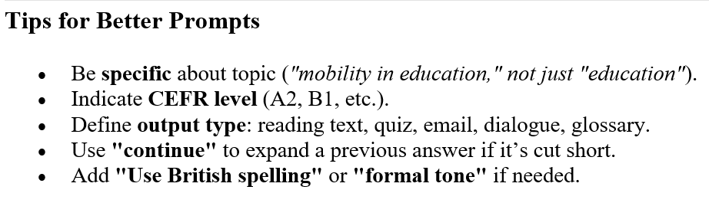

Slide 14

PROMPTING LIBRARY prompting principles
ID-Assist™

Slide 15
First Principle – CLARITY AND SPECIFICITY
Effective prompts prioritize clarity over brevity. While concise language may be efficient, clearly articulated prompts—sometimes requiring more detail—lead to higher-quality outcomes. Vague or underspecified instructions compel the model to guess intent, increasing the likelihood of inaccurate or irrelevant responses. To refine outputs:
If responses are excessively long, request a concise version.
If responses lack depth, specify a need for expert-level elaboration.
If the structure is unsuitable, provide an explicit example of the desired format.
A well-constructed prompt may include the following elements:
Instruction: A precise description of the task to be performed.
Context: Relevant background information or scenario framing the task.
Input Data: A text, question, or dataset that the model must analyze or process.
Output Indicator: A statement defining the expected format, style, or type of result.

Slide 16
Enrich Prompt Precision Through Contextual Modifiers
To optimize the effectiveness of prompts, educators and researchers are encouraged to incorporate contextual elements that clarify both intent and expectations. These optional modifiers serve to refine the model’s understanding and output quality. The following parameters may be included to enhance prompt specificity:
Tone: Define the intended style or attitude (e.g., formal, persuasive).
Format: Indicate the preferred output structure (e.g., outline, list, essay).
Role or Perspective: Specify the assumed identity or function of the model (e.g., expert, teacher).
Objective: Clarify the communicative purpose (e.g., to inform, entertain, instruct).
Audience and Scope: Identify the target audience, thematic breadth, keywords, and potential limitations.
Stylistic Examples: Provide samples or templates of desired content style or format.
Language Use: Include expected terminology, referencing style, and possible counterarguments.
Supportive Elements: Request inclusion of quotes, statistical evidence, visual references, or calls to action.
Sensitivity Markers: Flag topics that require careful or respectful handling.

Slide 17
Encourage Reasoning for Complex Tasks
It is essential to prompt the model to follow a structured, step-by-step reasoning process. This technique, the “zero-shot chain-of-thought prompting,” can be initiated by stating:
“Let’s think step by step.”
This scaffolding reduces the likelihood of reasoning errors or speculative outputs—commonly known as hallucinations—which occur when the model fills in gaps due to insufficient information or overly vague instructions.
To mitigate these risks, users should consider:
Providing clear and relevant reference materials as contextual support.
Prompting the model to identify and cite relevant quotations before generating an answer.
Iterative refinement is encouraged: test initial outputs, refine prompts or parameters, and repeat the process to achieve improved results.

Slide 18
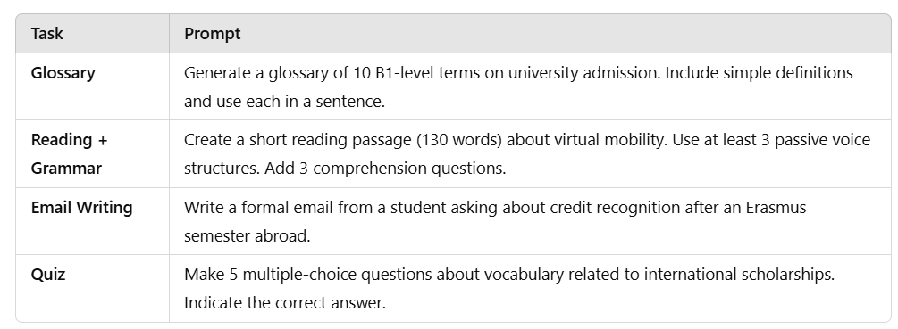
READY TO USE PROMPT TEMPLATES

Slide 19


Slide 20
Using My learning | Vocabulary.com in esp teaching

Slide 21
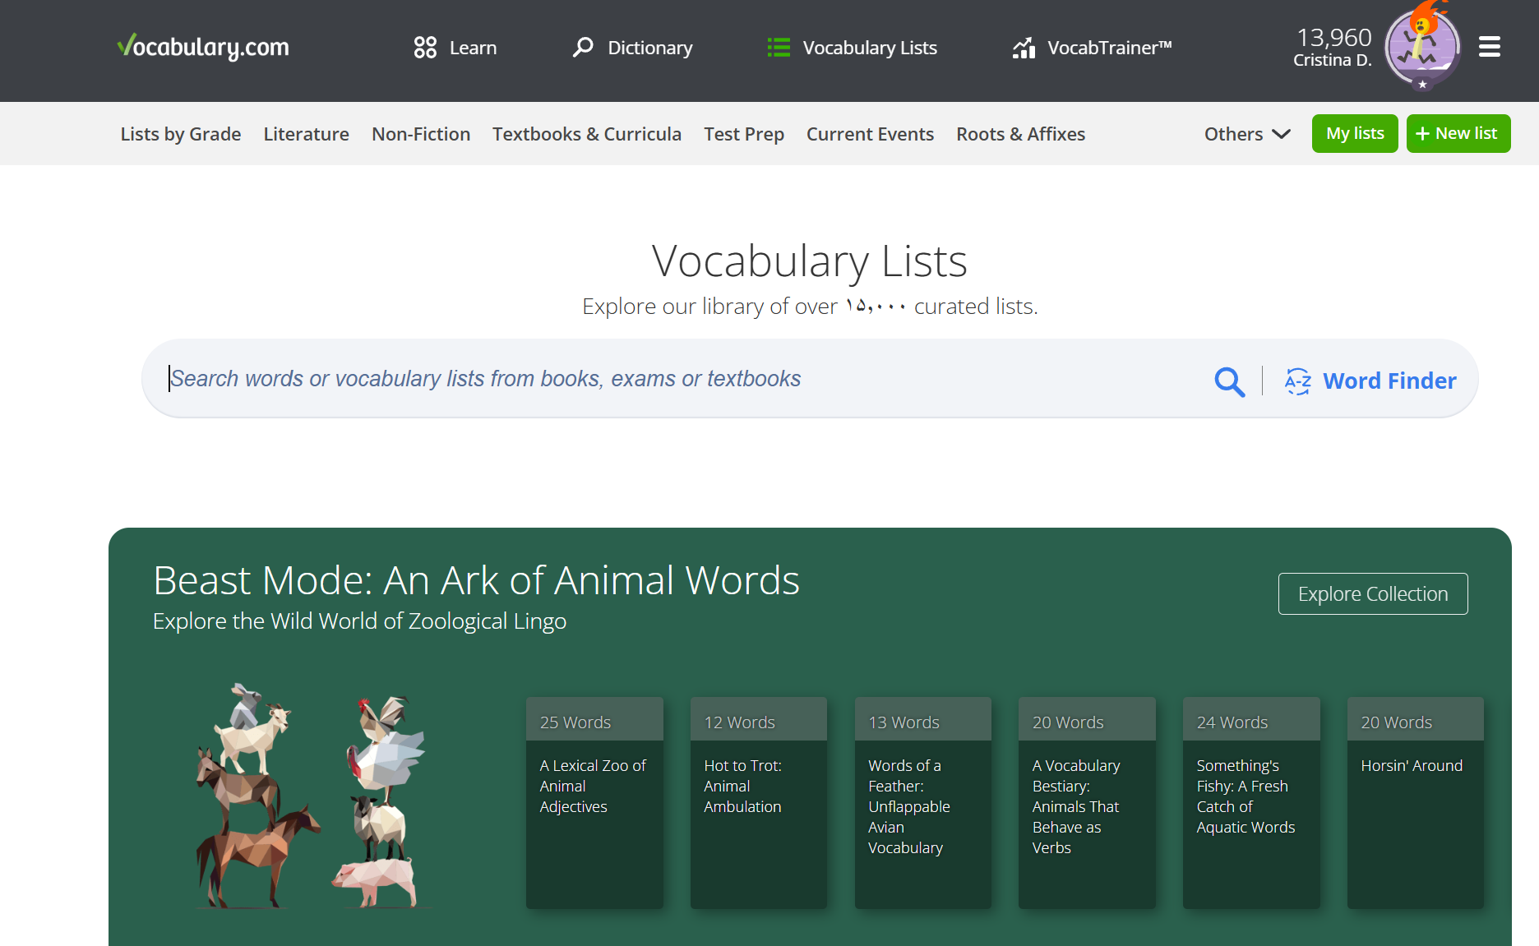


Slide 22
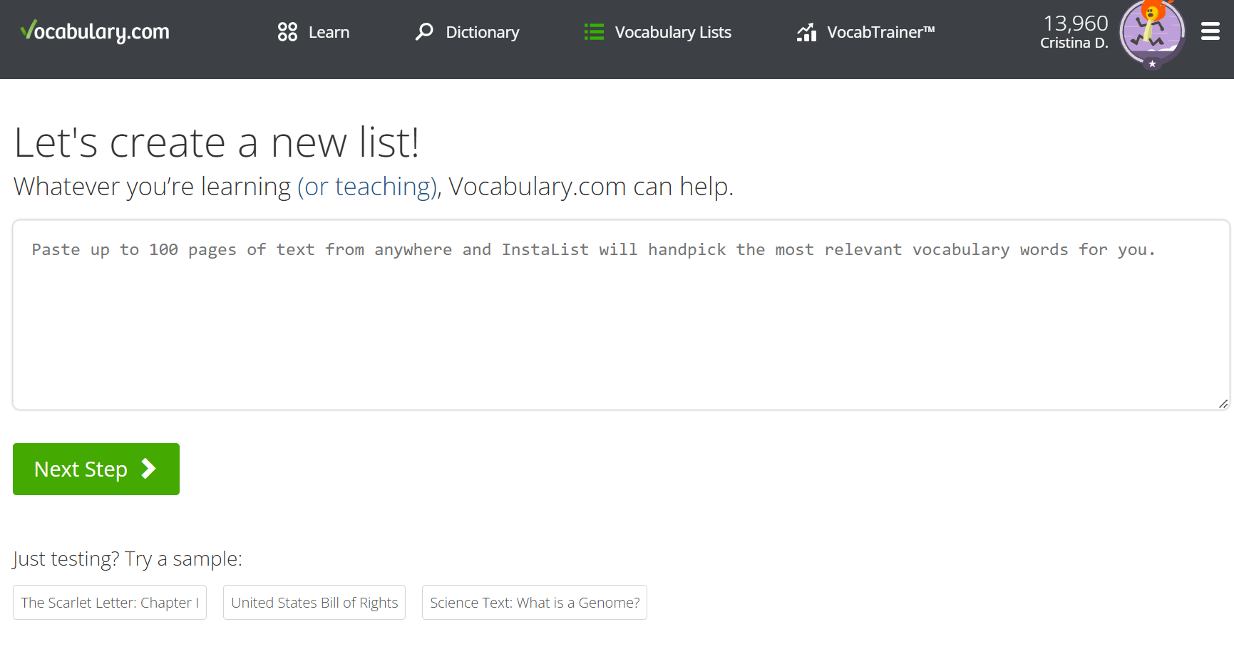

Slide 23


Slide 24


Slide 25


Slide 26

https://www.educaplay.com/

Slide 27
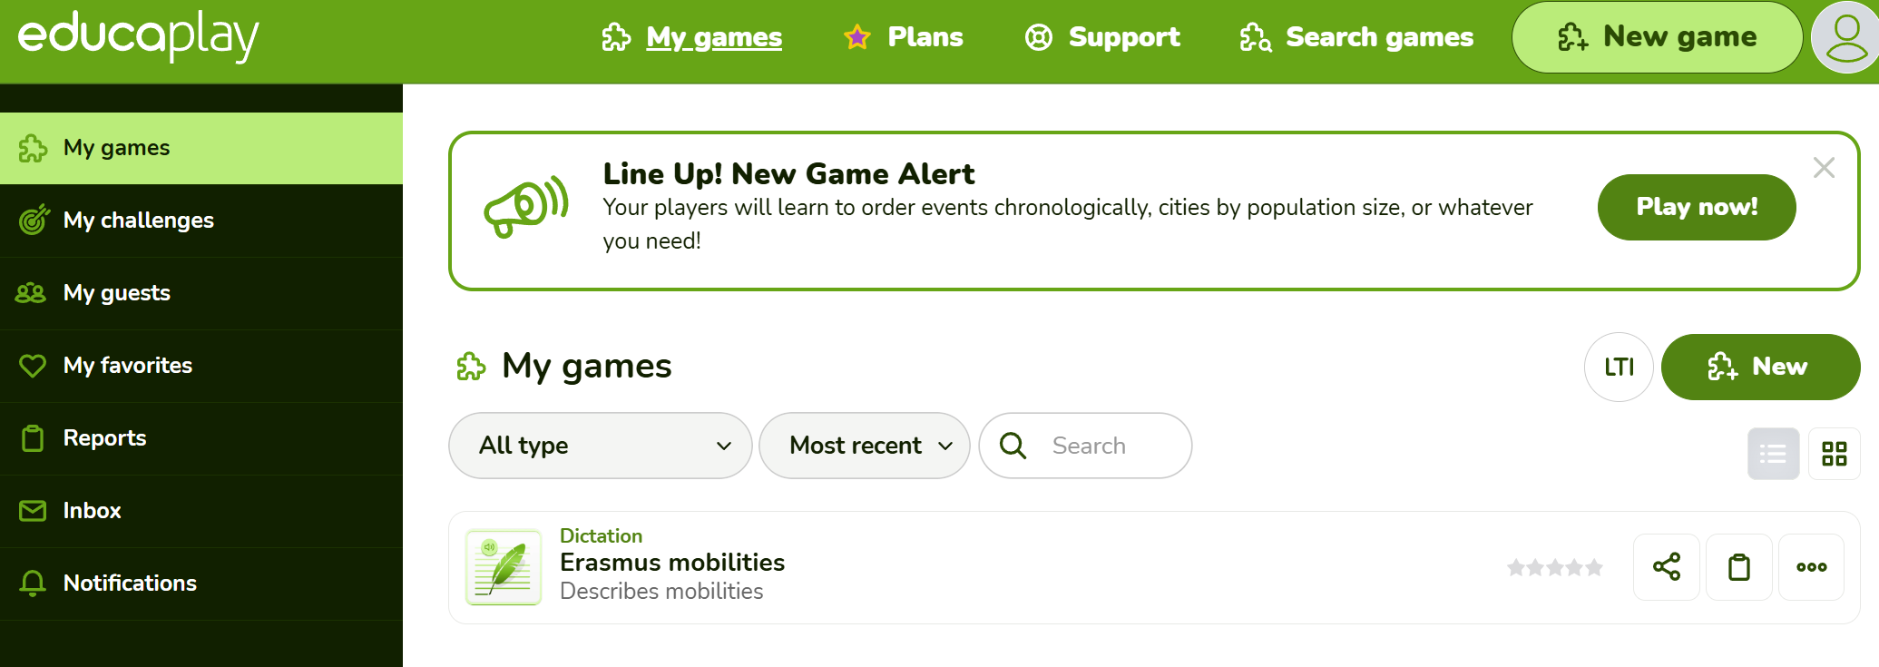

Slide 28
THANK YOU!
This research was supported by the Erasmus+ grant number 2024-1-RO01-KA220-HED-000248845”. “Funded by the European Union. Views and opinions expressed are however those of the author(s) only and do not necessarily reflect those of the European Union or the ANPCDEFP. Neither the European Union nor the ANPCDEFP can be held responsible for them

