Slide 1


ELITE-AI
Project Title: Empowering Specialized Language Acquisition with Integrated AI
Project code: 2024-1-RO01-KA220-HED-000248845
Project implementation: 01.09.2024-31.08.2026

Slide 2
Technicalities
1. There will be a certificate of attendance, issued at the end of the event to all participants present in the call today, sent by email.
2. The entire content of the Workshop (slides, links, etc.) will be made available to the direct participants after the event, via email.
3. The same email will contain an evaluation questionnaire about today's Workshop, which you are kindly invited to fill in.
4. The same email will contain a personalised list of attendance, which we would be grateful if you signed.
5. In case Zoom stops operating, please connect to:
https://teams.microsoft.com/l/meetup-join/19%3ameeting_Mjk3OGRmMmYtNTAzYS00Nzg1LTk1MGYtOGI3YjVkMjFlMmVi%40thread.v2/0?context=%7b%22Tid%22%3a%226e6ade15-296c-4224-ac58-1c8ec2fd53a8%22%2c%22Oid%22%3a%22e69a9a47-a5b7-4d5b-b086-3ffd40646e61%22%7d

Slide 3




Partner Institutions
Universitatea Transilvania din Brașov – Coordinator
Univerza V Mariboru – Partner 1
Universita degli Studi di Udine – Partner 2
Sveuciliste Jurja Dobrile u Puli – Partner 3

Slide 4

Logo
4

Slide 5



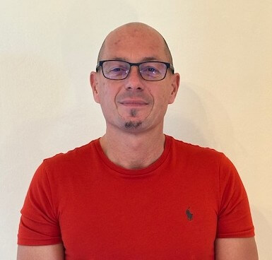





Project Members
:https//elite-ai.unitbv.ro/index.php/about-us/
UNITBV>
Andreea Nechifor, PhD - Project Manager
Cristina Dimulescu, PhD - Project Member
UM>
Mojca Kompara Lukančič, PhD – Institut. Coord.
Tilen Smajla, PhD - Project Member
UNIPU>
Iva Blažević, PhD - Institut. Coord.
Jelena Gugić, PhD candidate - Project Member
UNIUD>
Francesco Costantini, PhD - Institut. Coord.
Eleonora Gallitelli, PhD - Project Member
Emanuela Li Destri, PhD candidate - Project Member

Slide 6
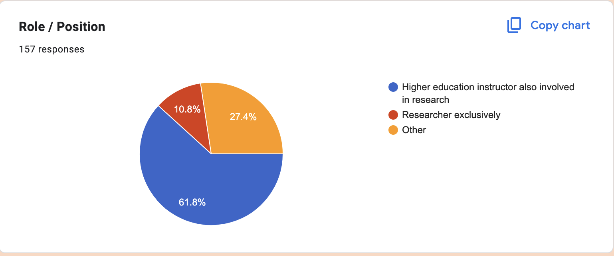
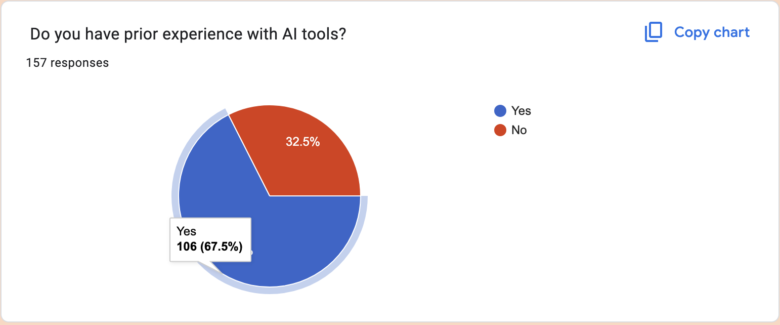
Assessing the audience
6

Slide 7
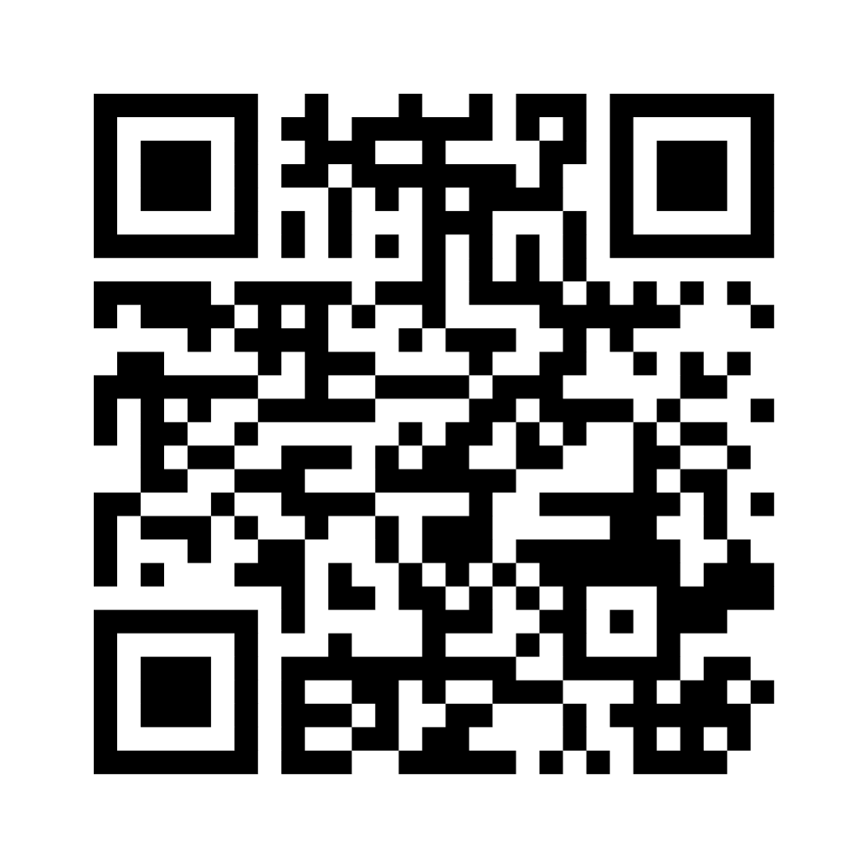
Q1 & Q2
Mentimeter
https://www.menti.com/al78tdmq3eqg

Slide 8
― Someone Famous
“
"AI doesn't replace teachers – it empowers them to inspire.".
”
8
Notes:
Claude, after refusing to generate a negative quote about itself seen as threat to education

Slide 9
― Someone Else, Equally Famous
“
9
"I am not a threat to education - I am a challenge to outdated thinking. The real danger is a system that fears questions more than ignorance."
”
Notes:
ChatGPT

Slide 10
Project Aim:
The modernization of FL acquisition through digital tools and AI integration, empowering practitioners (students, teachers, researchers) with contemporary methods, specifically targeting the ESP field.
10

Slide 11
Project Objectives (1):
01
02
03
04
Introduction
Our outputs
to review literature on AI integration in education, mainly in FL classes and especially regarding ESP environments
to create online educational resources
Our work
Our subjects
to develop an AI solution database for ESP instruction
to implement AI tools across teaching, learning, and assessment levels
11

Slide 12
Project Objectives (2):
01
02
03
04
12
Introduction
Our work
to identify best practices
to integrate AI into language acquisition methodologies
Our output
Our subjects
to develop training materials
to evaluate their impact on teachers, students and researchers

Slide 13
Metrics
13
4 Work packages
18 dedicated activities
15 outputs

Slide 14
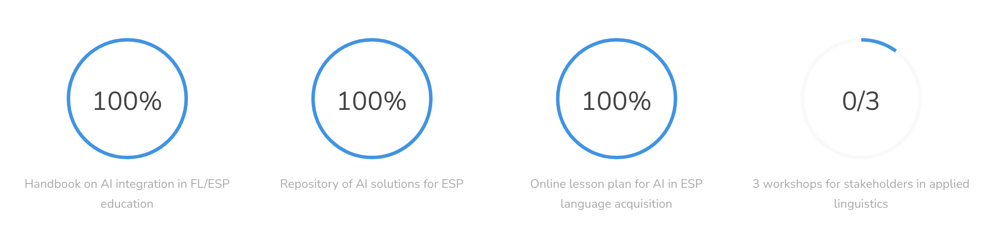
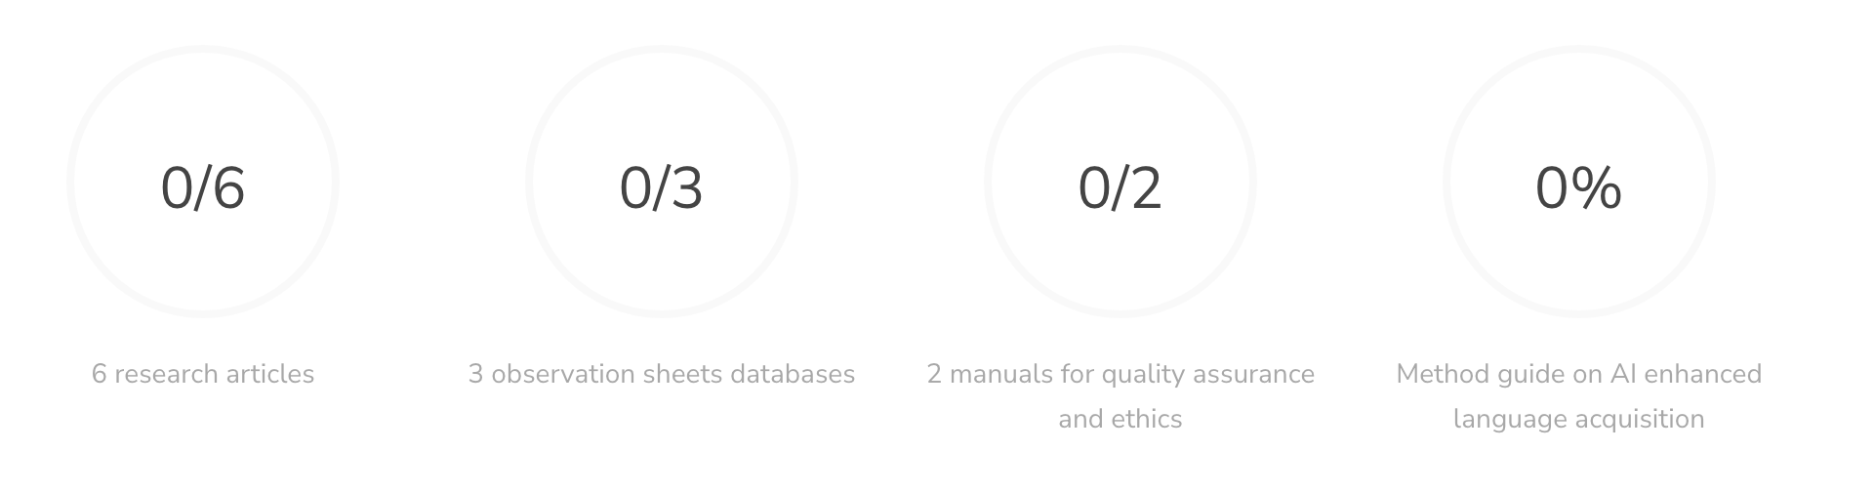
Project Results:
14
  a handbook on AI integration in FL/ESP education
  a repository of AI solutions for ESP
  an online lesson plan for AI in ESP language acquisition
  3 workshops for stakeholders in applied linguistics
  6 research articles
  3 observation sheets databases
  2 manuals for quality assurance and ethics
  a method guide on AI enhanced language acquisition

Slide 15
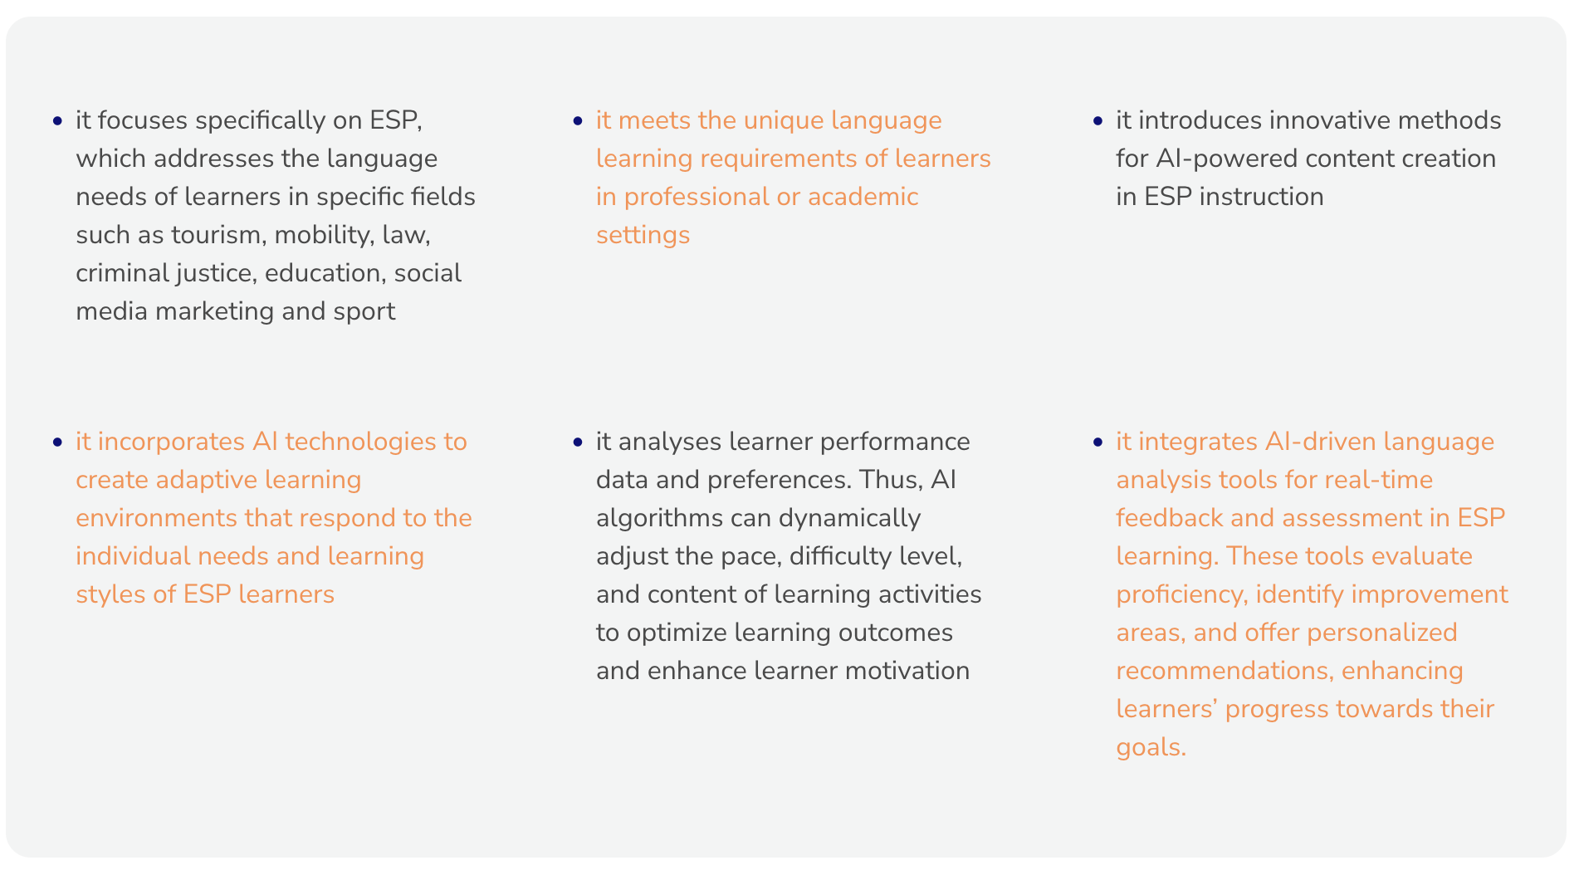
Project Innovation:
15

Slide 16
Added Value at an EU Level (1):
managing linguistic diversity
harmonizing educational standards
Diverse linguistic and cultural perspectives are integrated, tapping into a wealth of linguistic diversity, enabling the pooling of linguistic resources from various member states, creating a more comprehensive and varied language learning experience, and allowing for the aggregation of data from diverse linguistic contexts. The scale of data collection provides more robust insights into the effectiveness of AI-driven language learning methods across different languages and cultural backgrounds, forming best practices and contributing to the continuous improvement of language education strategies.
by aligning methodologies, assessment criteria, and learning outcomes, according to a cohesive European approach to language education. This standardization ensures consistency and facilitates cross-border recognition of language proficiency, gaining broader transnational recognition, enhancing the credibility and acceptance of the project's results, such as standardized language proficiency assessments and innovative language learning methodologies.

Slide 17
Added Value at an EU Level (2):
optimizing resource allocation
facilitating transnational validation
generating comprehensive data insights

Slide 18
WP2
to examine the relevant literature in order to identify relevant research in ESP instruction and AI integration
Specific Objectives
to develop a database of AI solutions tailored for ESP instruction, creating online educational resources for ESP language acquisition with AI-driven tools
18
to organise a workshop for researchers to collaborate on innovative approaches to ESP instruction and AI integration

Slide 19
WP2 Results:
19
  a handbook on AI integration in FL/ESP education
  a repository of AI solutions for ESP
  an online lesson plan for AI in ESP language acquisition
  1 workshop for stakeholders in applied linguistics

Slide 20
WP3
to to implement AI-powered language acquisition tools across all levels of education: teaching, learning, and assessment
Specific Objectives
to design ESP curriculum models that integrate AI technologies to improve language learning outcomes and provide real-time feedback on students’ language proficiency and progress. These models include interactive exercises, language analysis tools, and personalized learning pathways tailored to learners' specific needs.
20
to organise a workshop for teachers and students to collaborate on innovative approaches to ESP instruction and AI integration

Slide 21
WP4
to integrate AI into language acquisition methodologies by identifying best practices
Specific Objectives
to develop training
materials for educators
21
to evaluate the impact
of AI-integrated methodologies on student outcomes
to refine approaches through feedback gathered from real educational settings, ensuring that learner engagement, feedback, effectiveness, and ethical standards are upheld
to organise an online common workshop for stakeholders (policy makers)

Slide 22
Thank you!
Site: https://elite-ai.unitbv.ro/
LinkedIn: https://www.linkedin.com/company/elite-ai-erasmus/
Facebook: https://www.facebook.com/elite.ai.unitbv/
Email: elite-ai@unitbv.ro
22
Please keep this slide for attribution

