Slide 1
AI in language acquisition
Integrating AI support in ESP classes – online workshop
7 May 2026

Slide 2


Empowering Specialized Language Acquisition with Integrated AI
Project leader:
Transilvania University of Braşov (RO),
Partner institutions:
University of Maribor (SLO)
University of Udine (I)
Faculty of Educational Sciences, Juraj Dobrila University of Pula
“This research was supported by the Erasmus+ grant number 2024-1-RO01-KA220-HED-000248845”.
“Funded by the European Union. Views and opinions expressed are however those of the author(s) only and do not necessarily reflect those of the European Union or the ANPCDEFP. Neither the European Union nor the ANPCDEFP can be held responsible for them”.

Slide 3
Introduction to AI in education
Learning dynamics changed by rapid access to information
"We're scared of AI, but we're also embracing AI. We think kids will just give up on learning, but we also think AI will be the great equalizer."
Sal Khan, TED talk (https://www.ted.com/podcasts/www.ted.com/podcasts/sal-khan-says-ai-wont-destroy-education-transcript)
Fear and threat?
Or equalizer, assistant, teammate?

Slide 4

“AI system means a machine-based system that is designed to operate with varying levels of autonomy and that may exhibit adaptiveness after deployment, and that, for explicit or implicit objectives, infers, from the input it receives, how to generate outputs such as predictions, content, recommendations, or decisions that can influence physical or virtual environments.”
(European Commission, 2026).
Notes:
AI can filter knowledge and do independent tasks like computing or student search. Rahman, 2009
“An artificial intelligence-based English class model should instead be developed in conjunction with the teaching and learning of English” (Ghafar et al., 2023).

Slide 5


LM – language models - computational models that have the capability to predict word sequences and generate human language if given input.
LLM – large language models - advanced language models with excellent learning capabilities.
ITSs and generative AI

Slide 6
Intelligent tutoring systems
personalized approach to learning by acting as a teacher/expert who adapts to and manages learning according to the specific needs of each learner
Three intelligence tests (Burns and Capps, 1988):
the content has to be understood by the computer system which should be able to solve problems related to it;
the computer system must understand what the approximate level of knowledge the students who are going to use it have;
the computer must approach different levels of performance and reduce differences among them

Slide 7
Generative ai
analyse data, adapt and generate content (text, images, or music)
most important feature - the possibility to collect and organise data from different sources
ChatGPT – generative pretrained transformer

Slide 8
AI in language acquisition
Language learning involves complex skills (listening, speaking, reading, writing)
AI tools developed to specifically address learners’ needs – tailored learning environments
AI as assistant, not replacement
Necessity to integrate AI-based teaching models into traditional instruction

Slide 9


“Tech-savvy learners” (Hashim, 2018)
Introduction of new technologies – better motivation and engagement
Higher levels of language proficiency

Slide 10
The research – empirical study

Slide 11
Aim of the study and research sample
Is there a difference in learning English as a foreign language between two groups of students:
1. Experimental group – learning English with the use of AI
2. Control group – learning English without the use of AI
Sample: 42 female students (Early and Preschool Education) – two groups
Duration: winter semester (15 lectures); 45 minutes

Slide 12
Research protocol

Slide 13

Informed consent to participate in the study
Approval of the University’s Ethical Committee
Placement test (Gugić, Malenica, Mustapić Malenica, n.d. – PROVIZENG PROJECT at the University of Zadar)
12 lessons – both groups used identical teaching materials, but different methods
All four language skills + grammar + vocabulary
ESP – topics linked to Education (learning styles, multiple intelligences, famous pedagogues, formal communication/correspondence)
Experimental group – Students’ observation sheet – in-class activities
Language instructor – Teacher’s observation sheet
Both groups- end of semester – Students’ observation sheet – at-home activities
Final (end-of-term) test – listening and reading comprehension, grammar and vocabulary – 40 points altogether

Slide 14
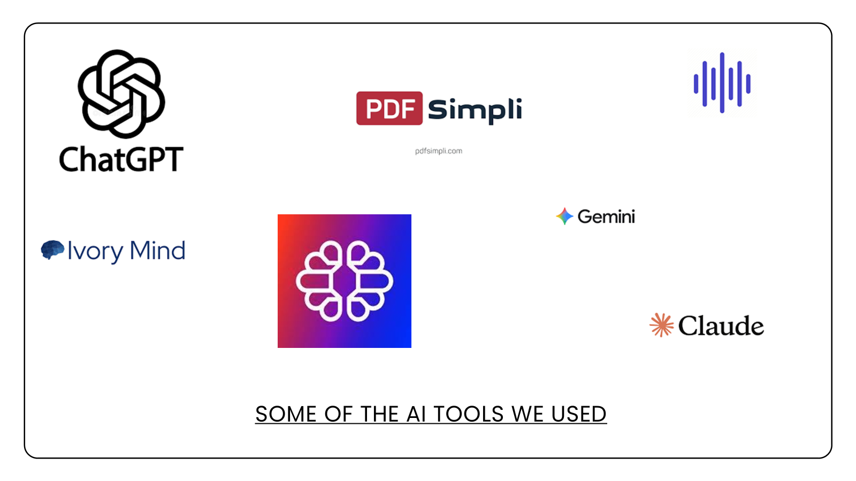

Slide 15
Statistical analysis - results

Slide 16
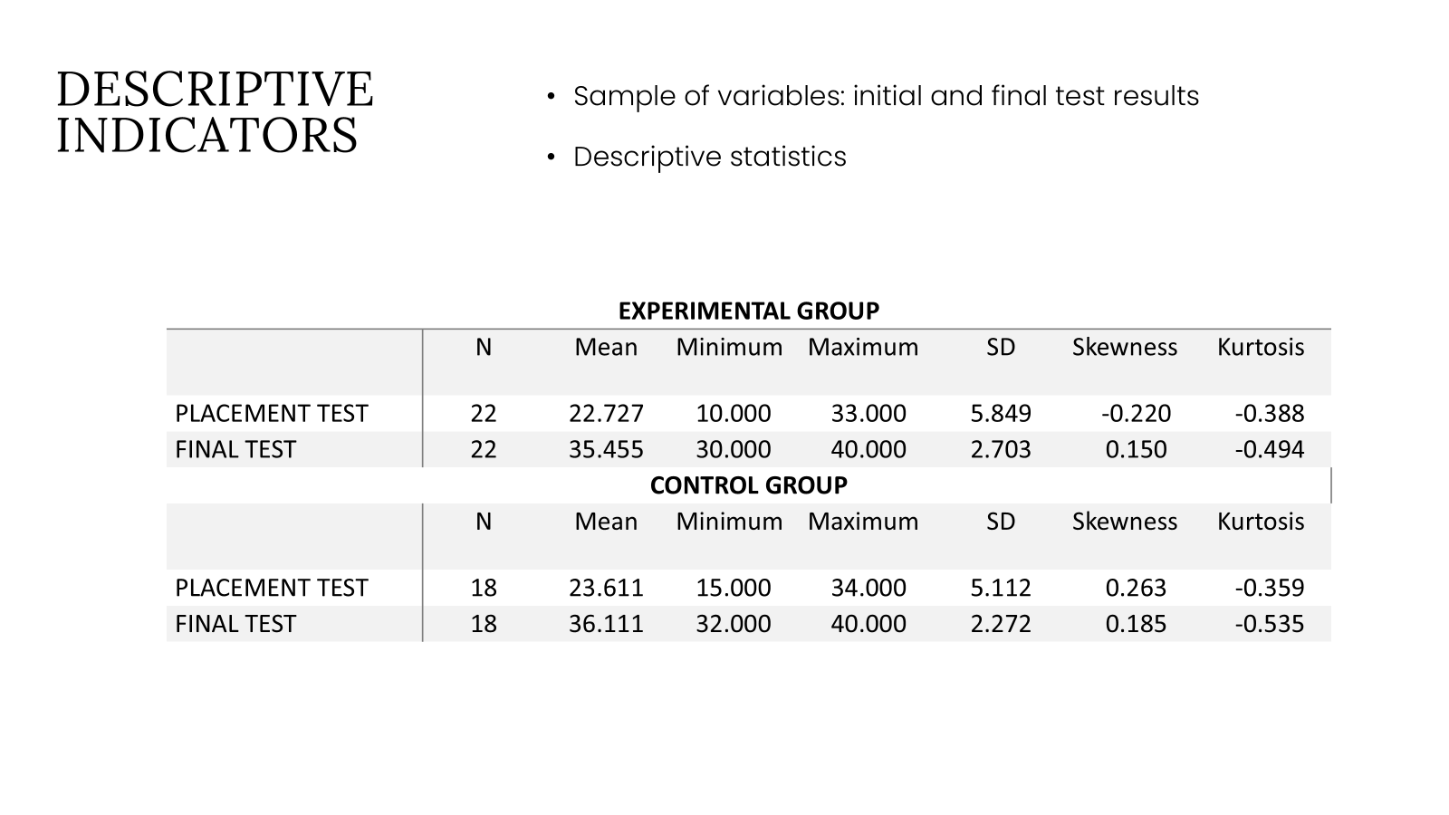

Slide 17

Descriptive statistics:
Control and experimental group – similar initial results (C=23.61 points; E=22.73 points)
Final test results also similar (C=36.11 points; E=35.46 points)
Results normally distributed
Parametric statistical methods - justified

Slide 18
T- test results
 | Mean CG | Mean EG | t-value | df | p | N CG | N EG | SD CG | SD EG | F-ratio Variances | p Variances
PLACEMENT TEST | 23.611 | 22.727 | 0.503 | 38 | 0.618 | 18 | 22 | 5.112 | 5.849 | 1.309 | 0.578
T-test – for independent variables – initial test results
Aim – to determine the initial comparability of the two groups
- Results – the groups were almost equal in their knowledge before the initiation of the experimental part of the project

Slide 19
Analysis of covariance (ancova) results
 | SS | Degr. of Freedom | MS | F | p
Intercept | 2362.630 | 1 | 2362.630 | 374.038 | 0.000
PLACEMENT TEST | 7.520 | 1 | 7.520 | 1.191 | 0.282
Group | 3.371 | 1 | 3.371 | 0.534 | 0.470
Error | 233.712 | 37 | 6.317

Slide 20
ANCOVA – to determine the effects of AI tools usage on the final test results
Results: the students’ initial level of knowledge was not a statistically significant predictor of the final result
No significant difference between the control and experimental group after the conducted research
The variables initial knowledge and group have a limited contribution in explaining the final test results.

Slide 21
conclusion

Slide 22

The use of AI tools did not have a significant impact on language acquisition in this research (reading, writing, vocabulary and grammar)
Food for thought:
The intensity of learning was not adequate
The lectures were too short (45 minutes)
Different use of AI tools
What is next?
Conduction of longer lectures (at least 90 minutes)
A larger number of participants

Slide 23

Thank you for your attention!

