Slide 1
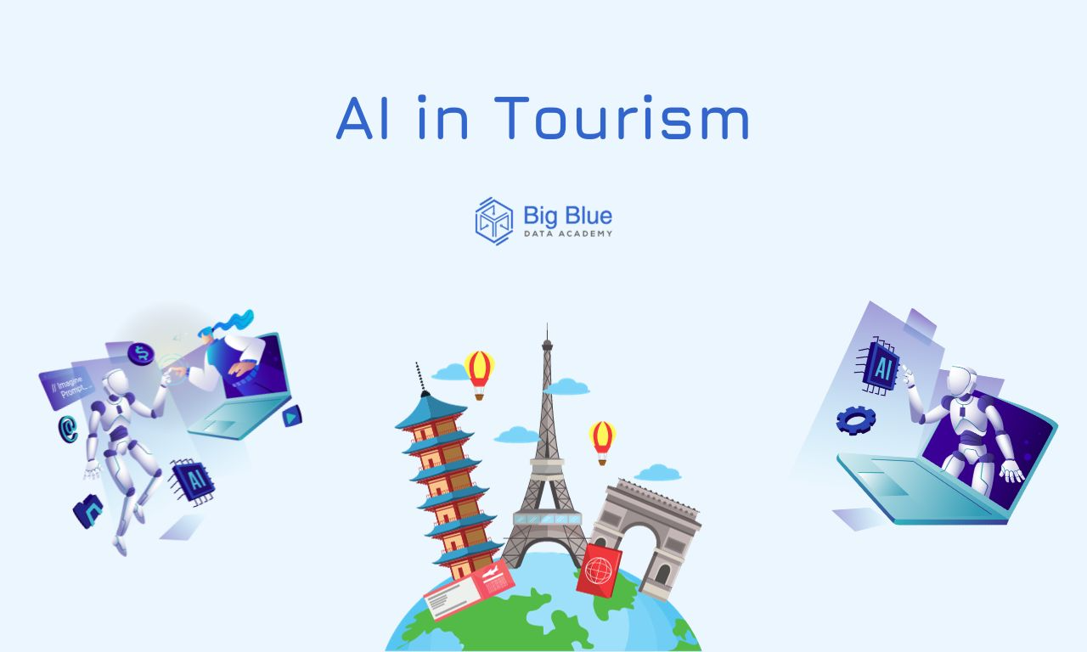
THE TRANSFORMATIVE ROLE OF AI IN TOURISM: SUCCESSFUL CAMPAIGNS
How artificial intelligence (AI) is shaping the future of the tourism industry, from marketing strategies to customer experiences.

Slide 2



EXPERIMENTING WITH AI
Definition and importance of generative AI in the tourism industry.
How AI can be leveraged to develop specialized language skills for tourism communication.
Examples of successful AI-generated campaigns and their comparison with traditional campaigns.
Exploring the creation and analysis of text and images using AI tools.
Introduction to Generative AI
AI-Powered Language Skills
Successful AI-Generated Campaigns
Experimenting with AI: Text and Image
Effective Tourist Advertisements
Discourse Analysis Tools
Multimodal Analysis in Tourism Communication
Discussion on the features that make a tourist advertisement (e.g., Instagram post) effective in drawing potential customers, with a focus on comparing human-generated and AI-generated content.
Overview of Systemic Functional Linguistics (SFL) Appraisal framework as a tool to approach tourism discourse analysis.
Exploring social semiotics and software for visual annotation to understand and create content for specific purposes in tourism communication.

Slide 3
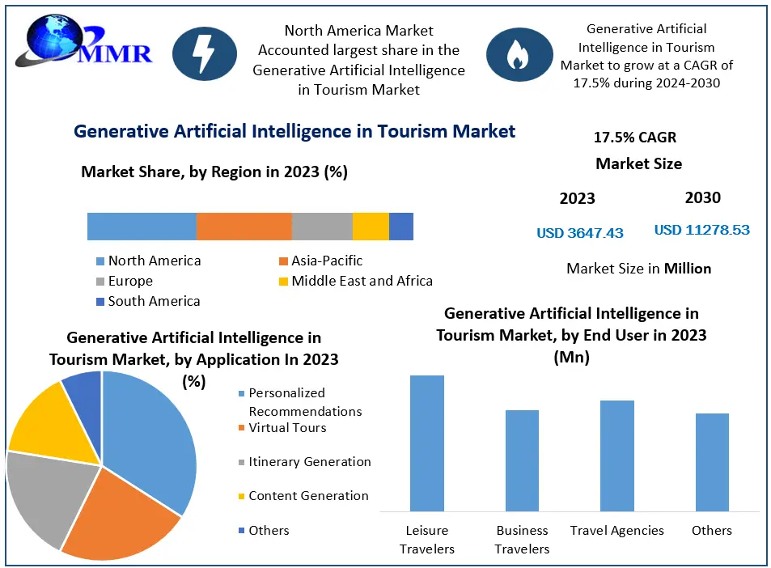
AI-POWERED LANGUAGE SKILLS
Generative AI has emerged as a transformative technology for the tourism industry, offering unprecedented opportunities to develop specialized language skills. By leveraging AI-powered language models, businesses can create highly personalized and engaging content that resonates with diverse international (multilingual) audiences, ultimately enhancing the customer experience and driving increased bookings.

Slide 4
What types of content (e.g., articles, social media posts, visual content) do you believe are best suited for AI generation in tourism?
Why?

Slide 5



THE EMERGING IMPORTANCE OF AI IN TOURISM MARKETING
Enhanced Customer Interactions
Personalized Content Creation
Real-time Adaptability
AI helps tourism businesses quickly respond to changing market trends and customer behaviors, optimizing their marketing strategies.
AI-powered chatbots and virtual assistants enable seamless, personalized customer support and engagement.
AI algorithms analyze customer data to generate hyper-targeted marketing materials, catering to individual preferences.
As AI continues to disrupt traditional tourism marketing practices, tourism professionals must adapt and leverage these transformative technologies to enhance customer interactions, personalize content, and maintain real-time adaptability, ultimately delivering more engaging and tailored experiences for the modern tourist.

Slide 6
SUCCESSFUL CAMPAIGNS
AI versus traditional

Slide 7
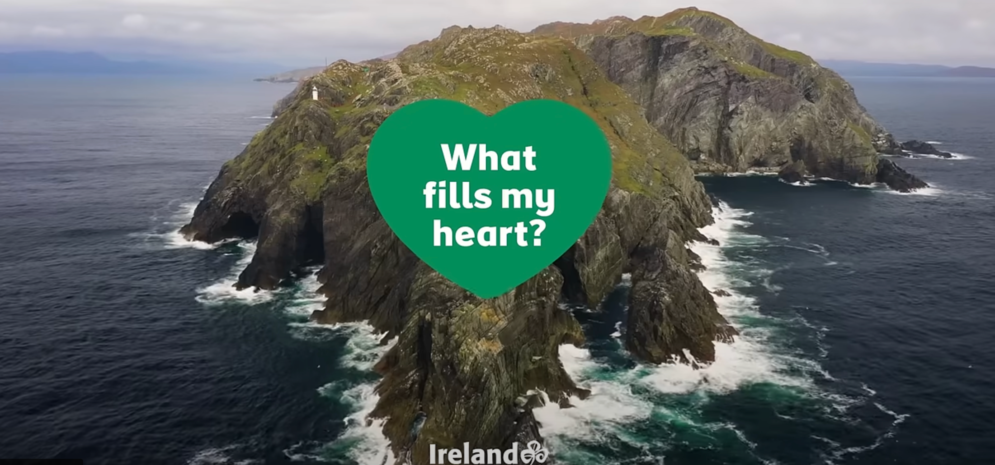
2024 Tourism Ireland campaign

Slide 8
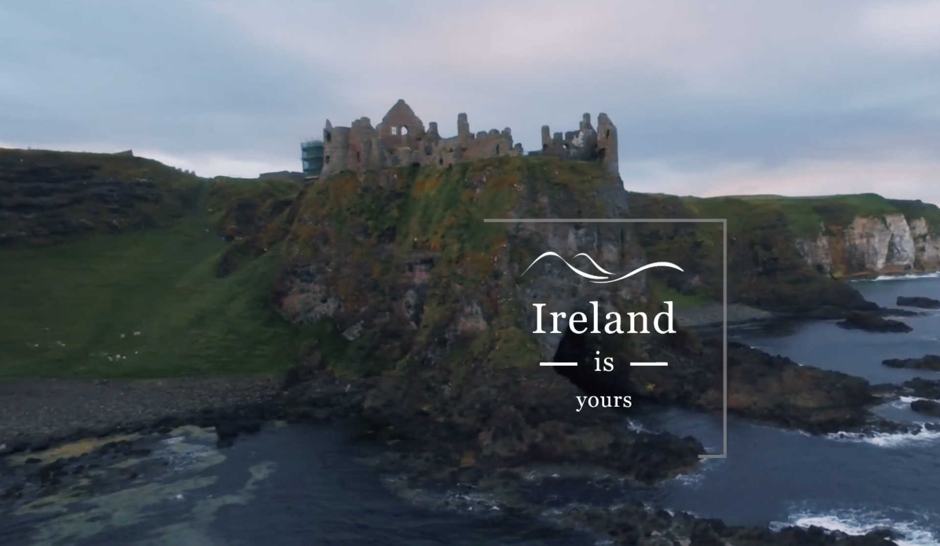
Tourism Ireland - Discover the Soul of Ireland campaign (@tourismireland)
Which strategies can you spot? Through which modes?
  music?
  Slogan?
  visual storytelling based on tourism tropes
  smiling tourists? interaction with locals?
  idyllic, aerial shots
  wildlife presence
  the untamed nature of untouched landscapes
Other travel boards with effective tourism content: @westernaustralia, @explorecanada, @dolomiti.it, @fvglive

Slide 9
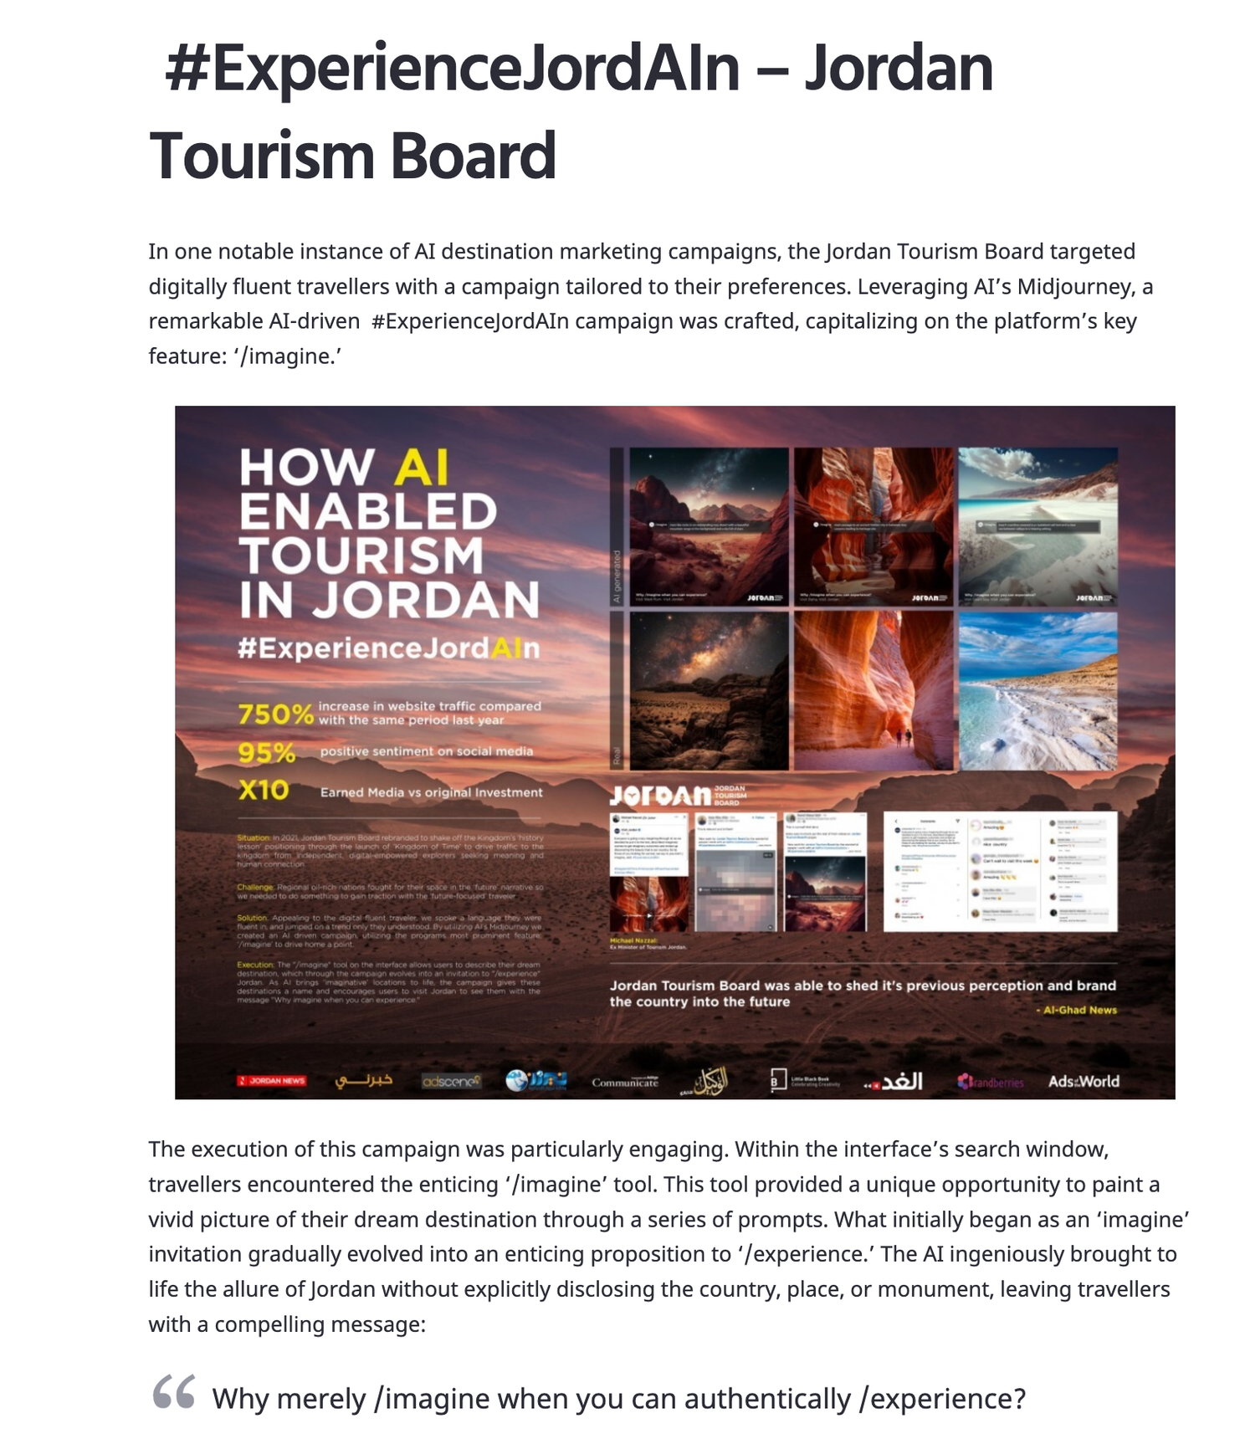
Why merely imagine when you can authentically experience?
AI-supported campaigns

Slide 10
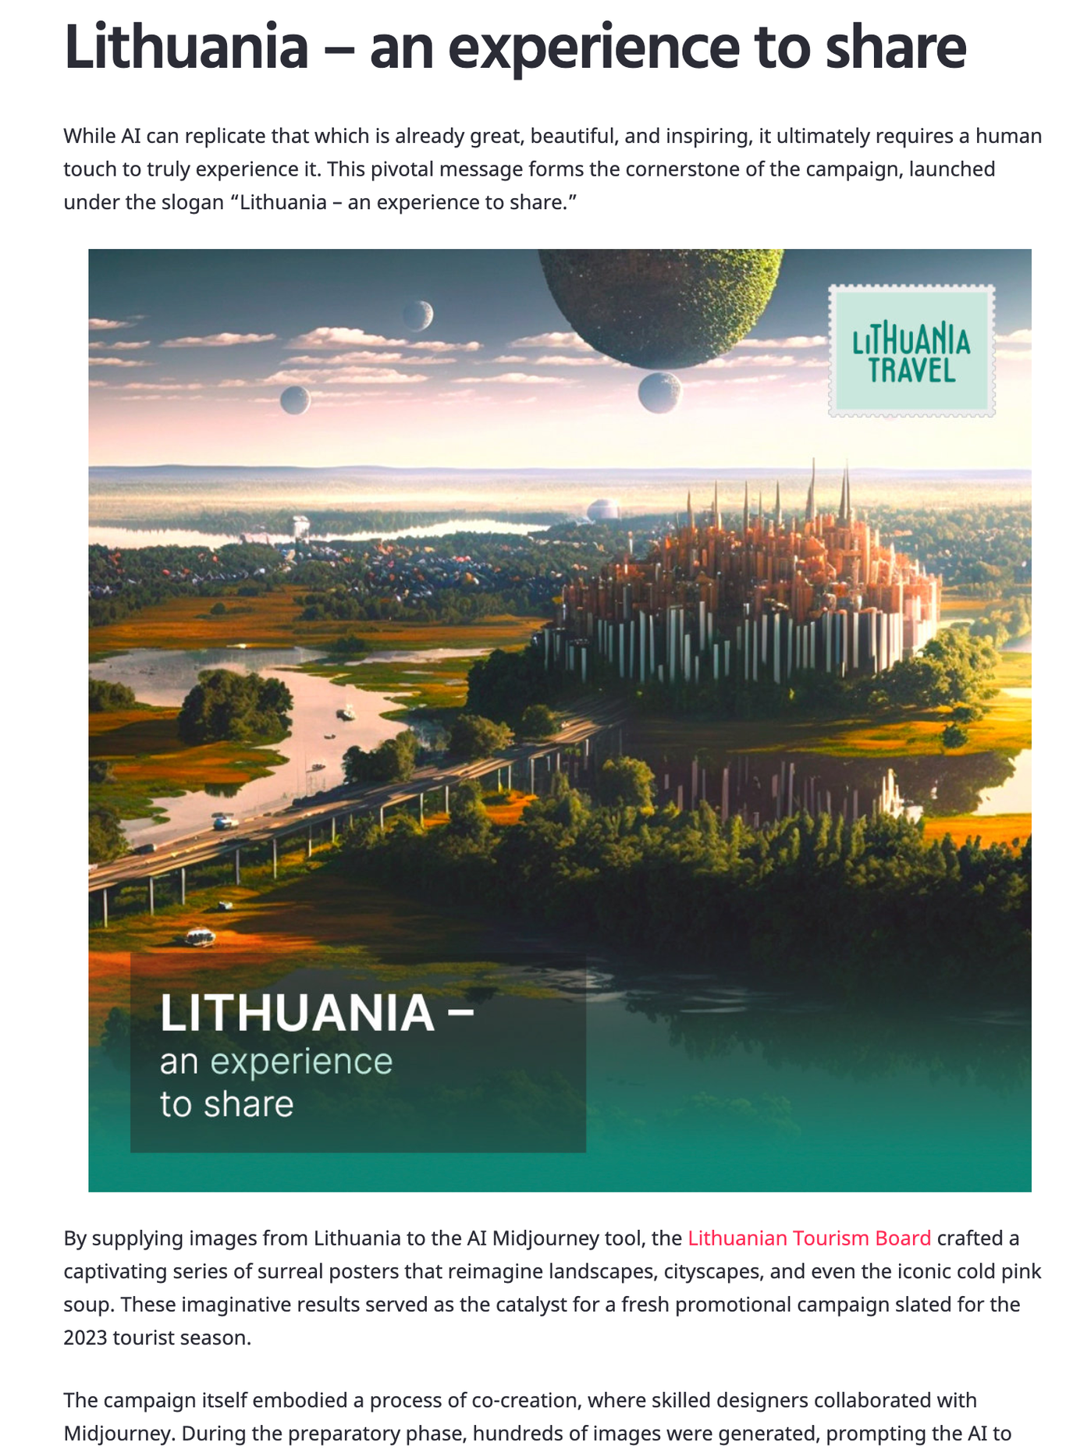

Slide 11
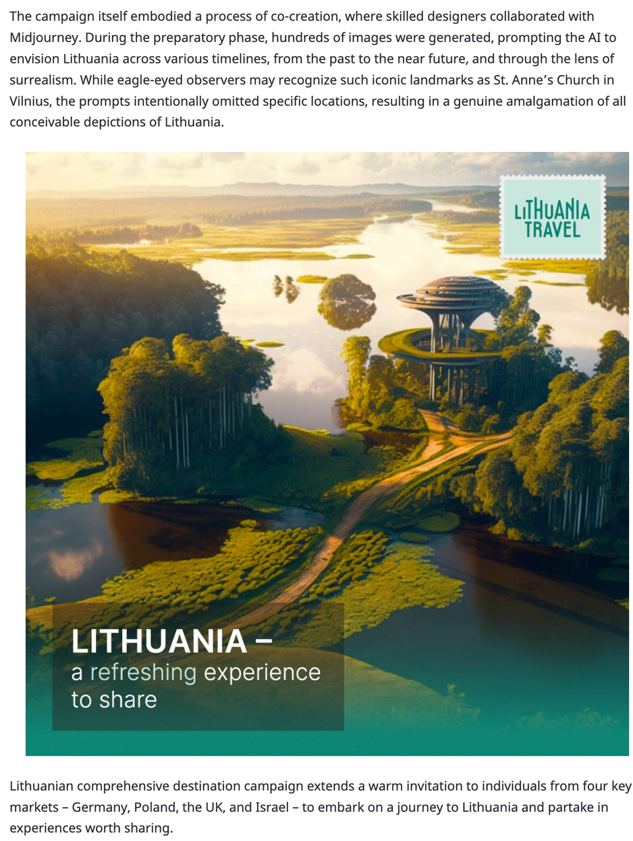
How important is authenticity in tourism content, and can AI-generated content maintain this authenticity?

Slide 12

REFLECTIONS
Do you like the visual campaigns? Why?
Do you think these campaigns might be effective? Why? At what stage of the planning and decision process?
What issues might arise when tourists actually visit the destination?
What is the role of the text? How do you know what you should write when feeding information to the machine? What would YOU WRITE?
Dive deeper: AI for tourism marketing: 1) text-to-image; 2) generate text. Meeting the needs of tourists after focus groups (markets, demographics) or finding inspiration for particular shots --> what about the needs of the local populations or the environment?
Imagination and personalization are key, but they need to reflect reality....contemporary digital imagery is already artificial and might stimulate desires or expectations that are not met during the travel experience - because they represent the REALM of IMAGINATION, not the real, physical experience!

Slide 13


BEST PRACTICES IN TOURISM COMMUNICATION
Clear & Compelling Messaging
Captivating Visuals
Crafting tourism messages that are concise, engaging, and resonate with the target audience.
Using high-quality, visually striking images and multimedia to capture the essence of the destination.

Slide 14



BEST PRACTICES IN TOURISM COMMUNICATION
Audience-Centric Approach
Successful Campaign Case Studies
Emotional appeal
Personalizing the content and experiences to match the specific needs and preferences of different customer segments.
Examining award-winning tourism campaigns that have demonstrated excellence in communication and achieved remarkable results.
Evoke positive emotions like adventure, relaxation, or nostalgia to create a memorable connection

Slide 15
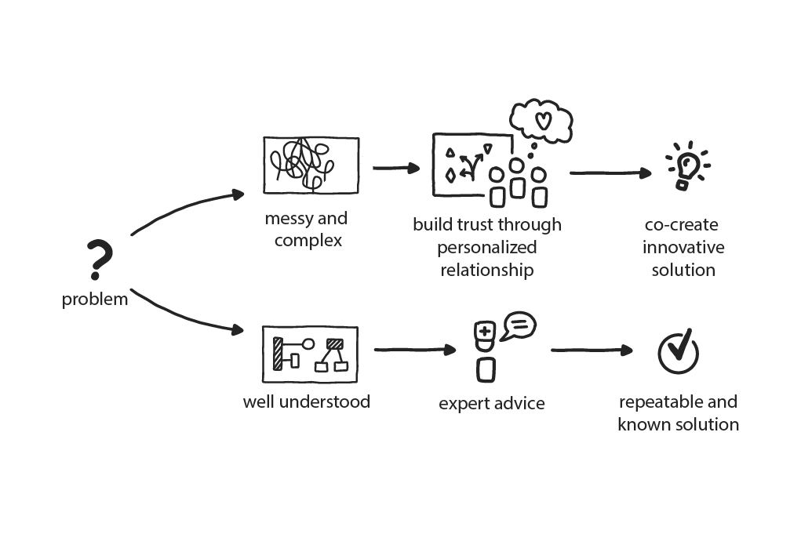
CO-CREATION AND PERSONALIZATION
AI facilitates the co-creation of unique tourism experiences through seamless collaboration between service providers and customers. By analyzing customer preferences and behavior, AI-driven systems enable personalized marketing strategies that cater to individual needs and enhance overall satisfaction.

Slide 16
CHALLENGES AND CONSIDERATIONS
Financial Investment
Data Privacy Concerns
Integrating AI technologies into tourism marketing requires substantial financial investment, which can be a barrier for some destinations and businesses.
As AI-powered systems collect and analyze large amounts of tourist data, there are growing concerns about data privacy and the ethical use of this information.
Algorithmic Transparency
Technological Expertise
Ensuring transparency in how AI algorithms make decisions and recommendations is crucial to build and maintain consumer trust in tourism marketing.
Implementing and managing advanced AI systems often requires specialized training and expertise, which can be a challenge for some tourism organizations.

