Slide 1
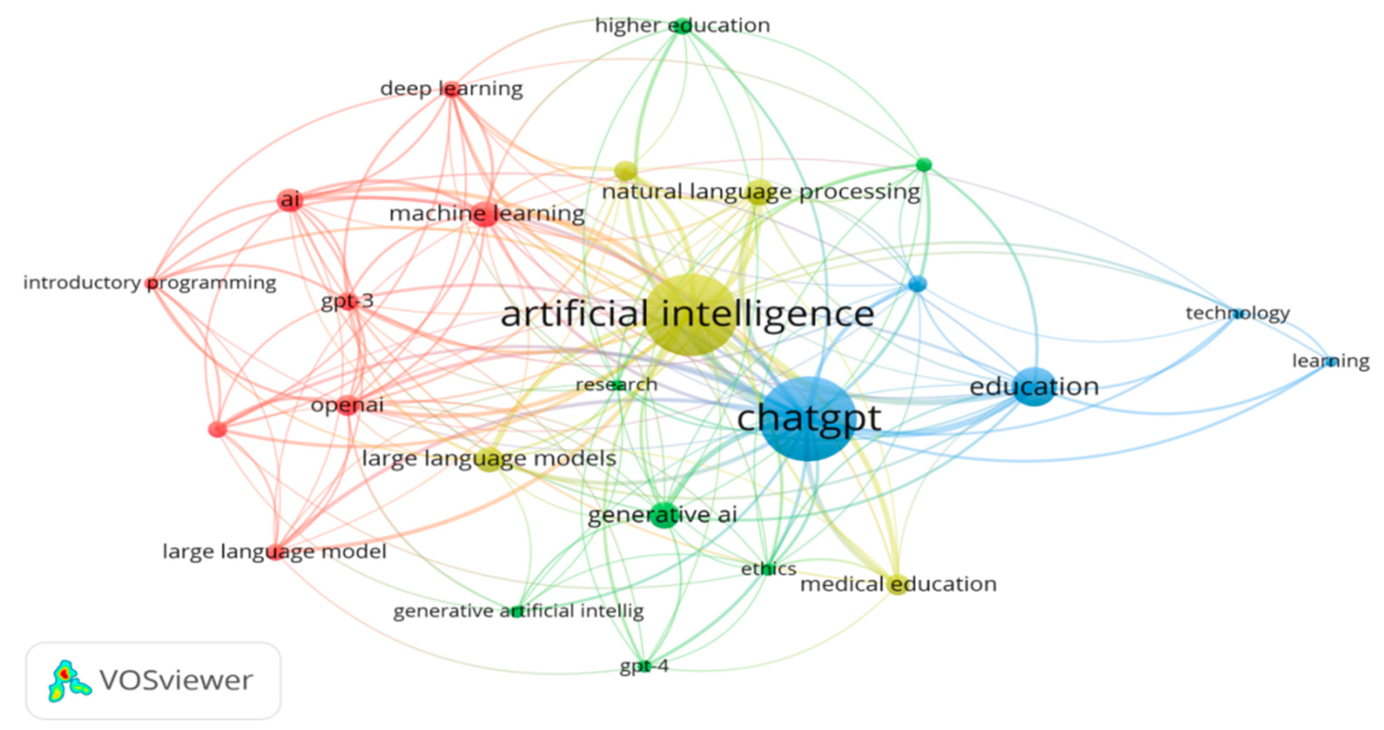
Exploring Generative AI for specialized language and semiotic skills development
How generative AI tools like ChatGPT can support content creation in the tourism industry
Notes:
intro on me and social media tourism images, ask questions, learn to leverage AI for tourism industry: knowledge about language, semiotics, rationale behind AI

Slide 2
Conference
This seminar
Introduction to AI
Examples and successful campaigns: Ai versus traditional
Experiments with Chat GPT and DALL-E
Exercises (data-driven)
Theory and software: how Multimodality can assist us in developing language and semiotic skills in studying and creating AI- and human-generated content
Workshop

Slide 3
Analyzing Tourism Discourse with AI: an overview
Introduction to Generative AI
AI for Specialized Language Skills
Successful AI-Generated Campaigns
Definition and importance of Generative AI in the tourism industry
How can AI be leveraged to develop specialized language skills for tourism marketing and communication?
Examples of AI-generated tourism campaigns and their comparison with traditional campaigns
Experimenting with AI
Effective Tourism Advertisements
Analyzing Tourism Discourse
Text and image analysis and creation using AI tools
Analyzing features that make an effective tourist advertisement (Instagram post) to draw potential customers
Using Systemic Functional Linguistics (Appraisal) and Multimodal Analysis to understand and create content for specific tourism purposes

Slide 4
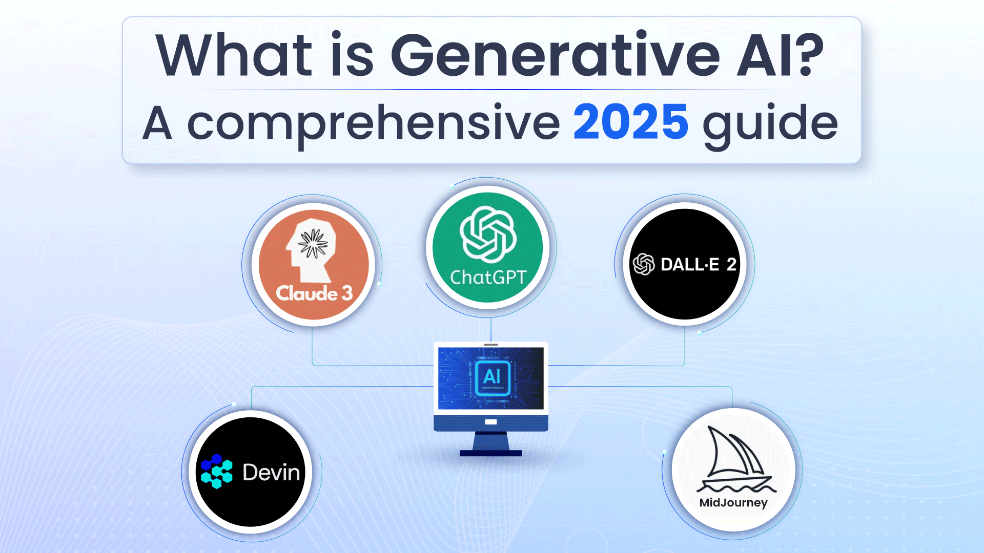
The Rise of Generative AI
Deep learning models are revolutionizing content creation by generating original text, images, based on user prompts.

Slide 5


Defining Generative AI
Definition of Generative AI
How Generative AI Works
Rise in Popularity
Generative AI creates original content (text, images, video, audio, or code) based on user prompts.
Uses deep learning models that recognize patterns in massive datasets to generate relevant responses.
The launch of ChatGPT in 2022 accelerated AI adoption, with one-third of businesses already using Gen AI and 80% expected to deploy it by 2026.
Generative AI is a rapidly growing technology that is transforming the way we create and interact with digital content.

Slide 6



How Generative AI Works =data and human feedback!
Training
Tuning (Adapting the model for specific applications)
Generation, Evaluation, and Retuning
A foundation model (e.g., large language models for text) is trained on massive, unstructured data. It uses 'fill in the blank' exercises to predict the next element in a sequence. This training process is resource-intensive, requiring high computing power and significant costs. Open-source models like Meta's Llama-2 help reduce these costs.
Fine-tuning: Feeding labeled data to refine output accuracy. Example: Training a customer service chatbot with real queries and responses. Reinforcement Learning with Human Feedback (RLHF): Humans evaluate AI responses, guiding improvements to the model.

Slide 7
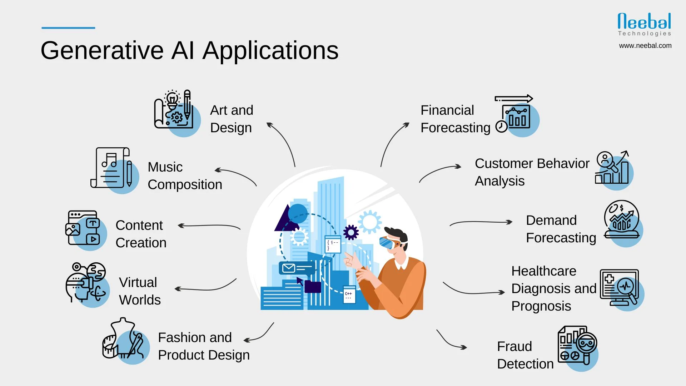
These models are trained on massive datasets to recognize patterns and generate relevant responses.

Slide 8
Have you ever experimented with AI in creating content?
What was your experience like?

Slide 9
How do you think AI can change the way we create and present tourism content?

Slide 10
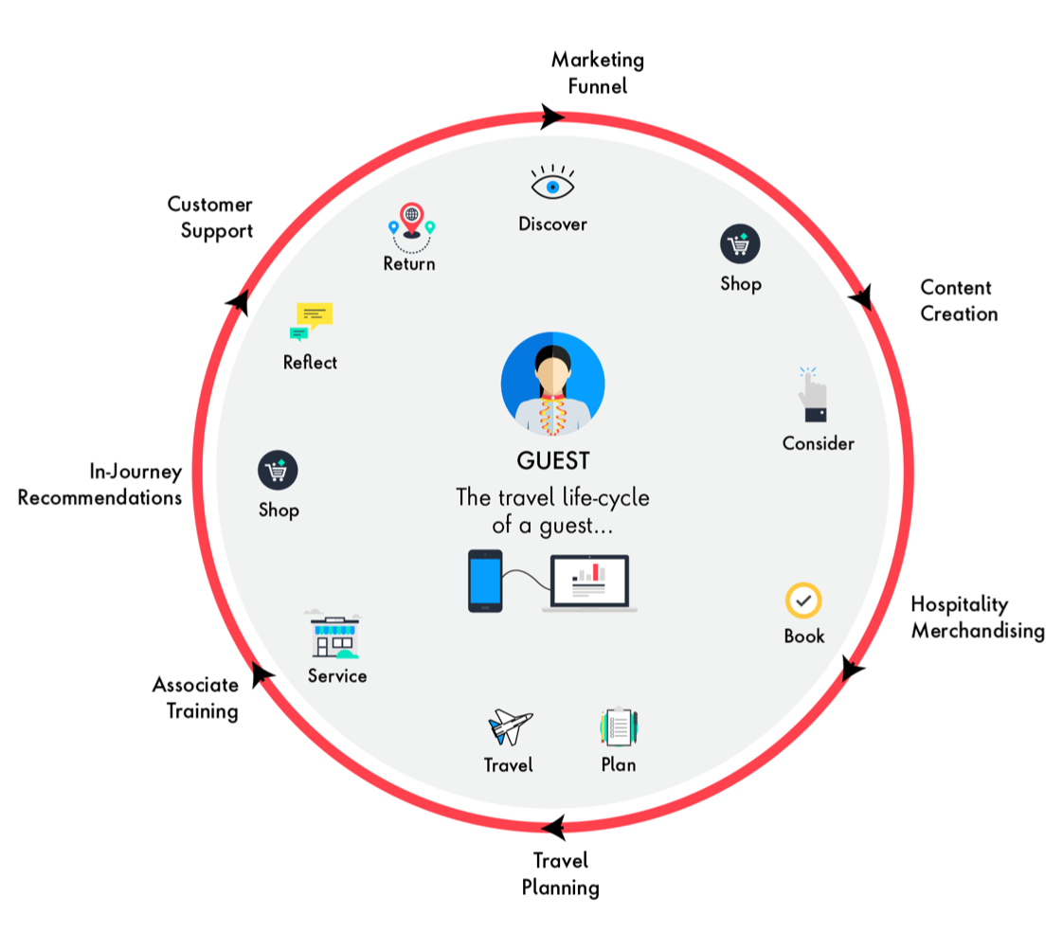
We know that...
Generative AI, powered by advanced language models like ChatGPT, is revolutionizing the way tourism professionals communicate and engage with their audiences. By leveraging these AI tools, tourism marketers can create personalized and highly targeted content that resonates with diverse traveler segments.
By understanding the principles of generative AI, tourism professionals can develop the language proficiency required to excel in their field and deliver exceptional experiences for their customers.

Slide 11
What are some ways AI can enhance personalized travel experiences through content?

Slide 12
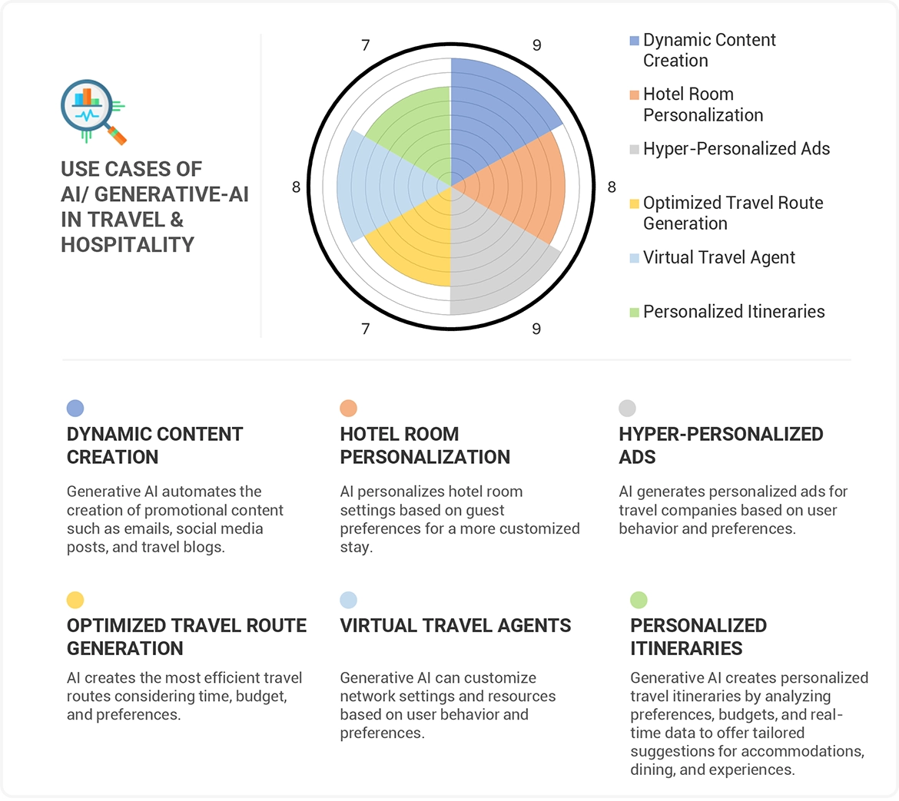
From generating real-time, customized content to enhancing overall tourist experiences, AI is reshaping the way destinations connect with their target audiences

Slide 13



Experience Enhancement through AI
Analysis, prediction, management
Optimizing Tourism Services
Managing Visitor Flows
Providing Real-Time Updates
AI-driven algorithms help analyze visitor data and trends to optimize tourism services, ensuring efficient resource allocation and enhanced visitor experiences.
AI systems can monitor and predict visitor flows, directing tourists to less congested areas and managing crowding at popular destinations, improving the overall experience.
AI-powered digital channels and platforms provide tourists with real-time information and updates, allowing them to navigate their trips seamlessly and adapt to changing conditions.

Slide 14






Dynamic Adaptability
1
Analyze real-time tourist data to identify evolving preferences and behaviors
2
Use predictive analytics to forecast demand fluctuations and resource needs
3
Implement AI-powered systems to automatically adjust service offerings and marketing strategies
4
Dynamically redirect visitors to less congested areas to enhance the overall experience
5
Provide real-time updates to tourists through AI-driven digital channels and chatbots
6
Foster a culture of continuous improvement by using AI insights to refine and optimize experiences

Slide 15







The Agenda for Smart Tourist Destinations
Enhanced Marketing
AI-powered personalization and real-time adaptability
Sustainable Governance
AI-driven policies for environmental and social impact
Optimized Services
AI-enabled management of visitor flows and experiences
Improved Quality of Life
AI-assisted initiatives for residents and tourists

Slide 16
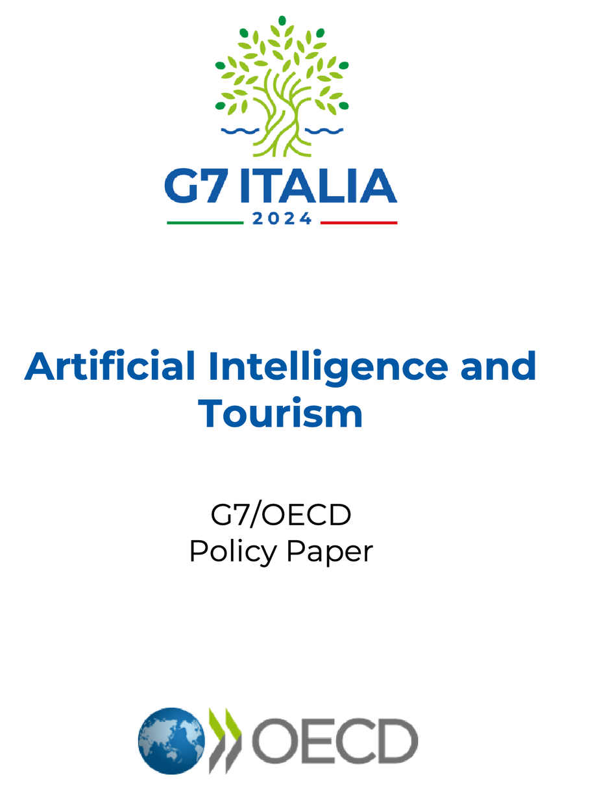
Policy paper
What about content creation?

Slide 17
What about writing for tourism?

Slide 18


AI Tools in Tourism Content Creation
Generative AI: Creating new content autonomously
AI-Generated Promotional Content
AI can create engaging and diverse tourism marketing materials, from social media posts to virtual tours, that can potentially exceed human-generated content.
Algorithms like ChatGPT, Claude, Gemini and DALL-E are transforming content creation in tourism by generating text, visuals, and even video with minimal human intervention.
AI-Powered Personalization
AI Biases and creativity
AI tools can analyze customer data to deliver hyper-personalized marketing materials, such as customized travel itineraries and tailored promotional campaigns.
AI-generated content may perpetuate cultural biases and stereotypes, requiring critical analysis to ensure inclusivity and respect for diverse audiences.It can also hamper or exceed human creativity.
As tourism professionals, understanding the potential and challenges of AI-powered content creation is crucial to understanding the evolving landscape of tourism marketing and delivering positive experiences for travelers.

Slide 19


AI Tools in Tourism Content Creation
Overview of AI tools
Use cases in tourism
Creativity of AI-generated content
AI tools can generate texts (e.g., ChatGPT, Claude), visuals (e.g., DALL-E, Gemini), and even video content with minimal human intervention.
AI can be used to write travel blogs, generate personalized travel itineraries, and create other tourism-related content.
Discussion on whether AI-generated content can match or exceed the creativity of human-generated content in the tourism industry.
Notes:
his slide provides an overview of the various AI tools that can be used for generating tourism-related content, highlighting the use cases and exploring the ongoing debate around the creativity of AI-generated content versus human-created content.

Slide 20




Promotional Materials Analysis
Analyzing Language Choice: lexis and register
Evaluating Design Elements
Identifying Audience Targeting
Analyzing Emotional Appeal
Examine the language used in promotional materials, including tone and targeted vocabulary (adjectives, action verbs, imperative statements)
Assess the visual aspects of the materials, such as layout, color schemes, imagery, and overall aesthetics.
Determine the target audience (demographics or persona) for the promotional content and how it is tailored to their preferences/needs. It can be young adventure-seekers, luxury travelers, or families.
Examine the use of emotional triggers, such as adventure, relaxation, or exclusivity, to engage the audience.
By analyzing the key features of both traditional and AI-generated promotional materials, we can gain valuable insights into effective tourism marketing strategies and develop a critical eye for assessing the quality and impact of content.

Slide 21


Multimodal Analysis in Tourism Communication
What is Multimodal Analysis?
Impact on Audience Perception
Examines how different modes of communication (text, visuals, audio) interact to create a cohesive message
Analyzes how the combination of communication modes affects the way tourists perceive and engage with a destination
Modes of Communication
Explores the interplay between written content, images, videos, and other media used in tourism advertising
Practical Application
Evaluating tourism promotional materials through a multimodal lens to understand their effectiveness
Multimodal analysis provides a comprehensive framework for understanding how tourism communication leverages various modes to create compelling and impactful messages. By examining the interplay of these elements, tourism professionals can enhance their promotional strategies and better connect with their target audiences.

Slide 22
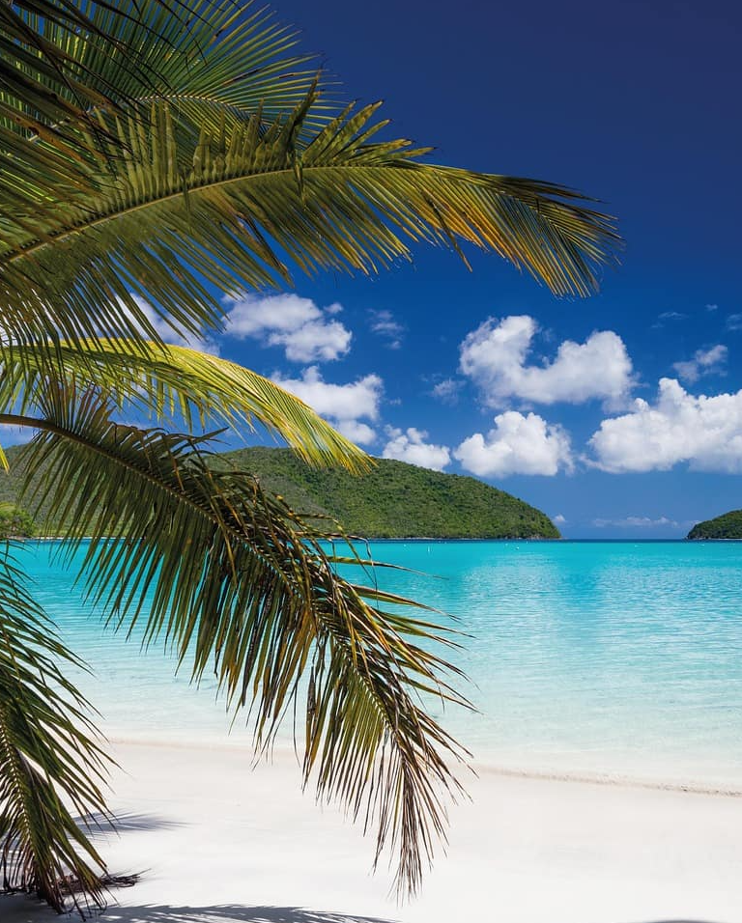
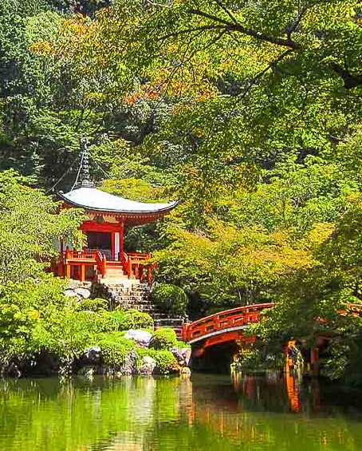
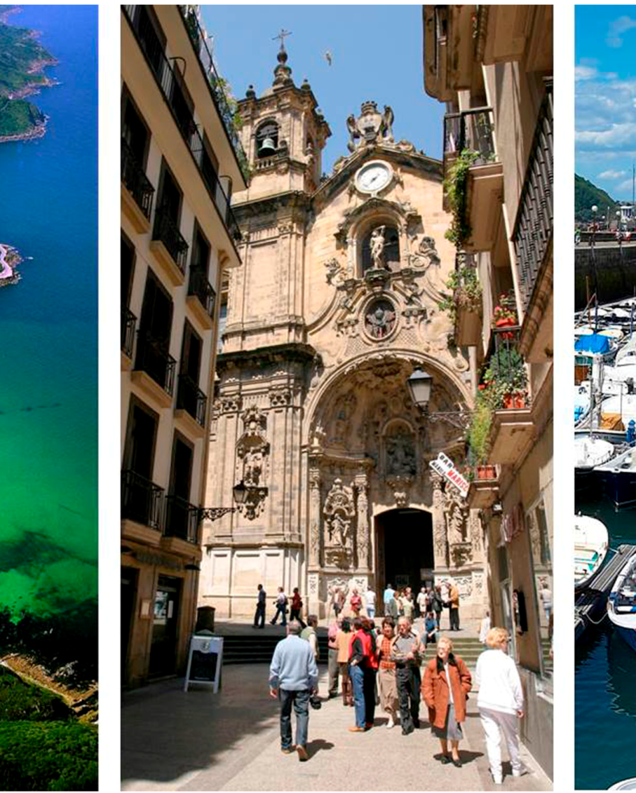
Multimodal Analysis in Tourism
?
Stunning Beach Landscape
Cozy Mountain Cabin
Vibrant City Skyline
Historic European Town
A charming log cabin nestled among the majestic mountains, surrounded by lush forests and serene lakes.
A dynamic cityscape with towering skyscrapers, bustling streets, and a vibrant cultural scene.
A picturesque European town with cobblestone streets, colorful buildings, and a centuries-old cathedral.
A breathtaking image of a pristine beach with crystal-clear waters and palm trees swaying in the breeze.

Slide 23
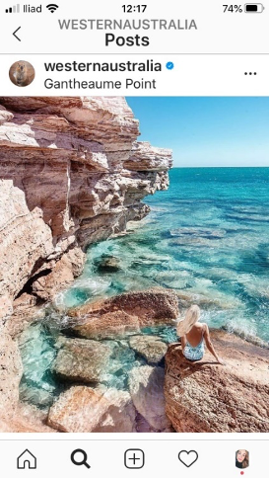
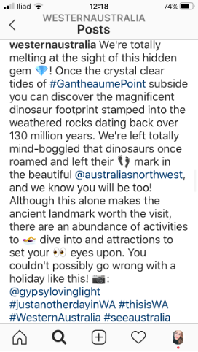
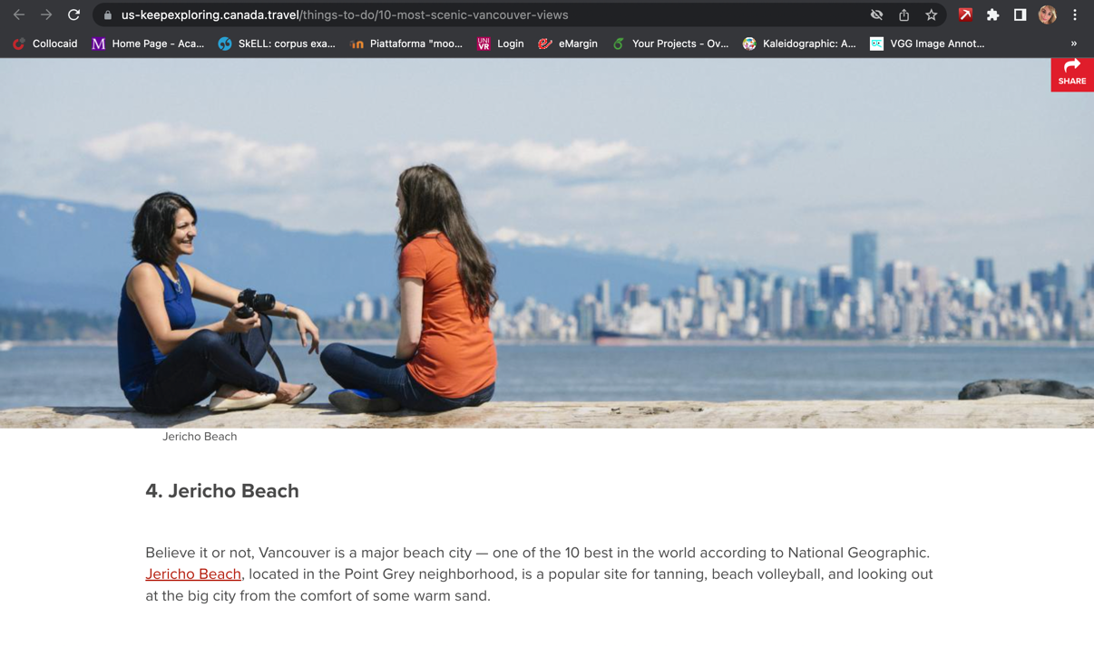
Image 5.1: Post shared by Western Australia on Instagram on 6th June 2019. Photo by @gypsylovinglight. www.instagram.com/p/ByWnWdon-FP/ (Last visit: 31/01/2023)

